Slide 1



Korean Android Financial
Menace
FakeCalls

Slide 2

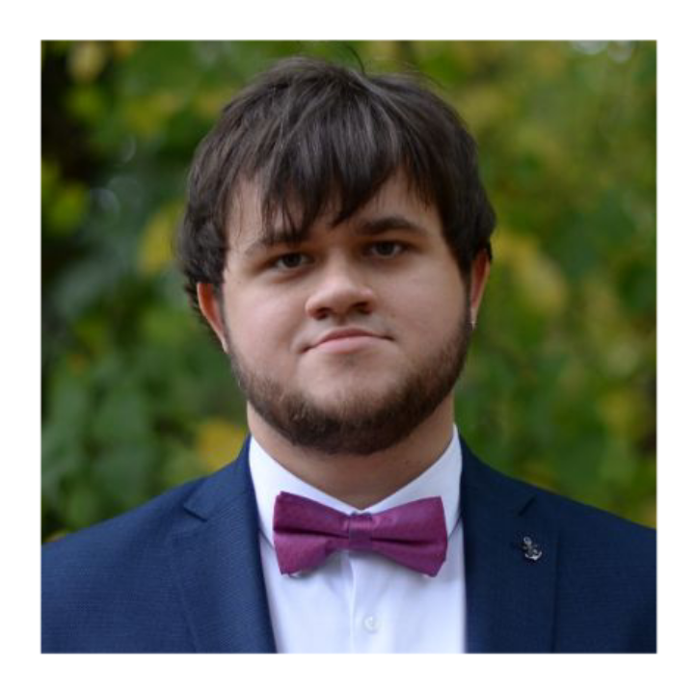
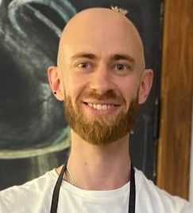

Researchers
Bohdan Melnykov
Raman Ladutska
@_mbv06_
@DaCuriousBro

Slide 3
Agenda
1. Voice-phishing in South Korea
2. FakeCalls malware
3. Evasion techniques
4. Functionality cherry-picks
Summary

Slide 4
Voice-phishing in South Korea
1

Slide 5




Voice phishing: state of affairs
.
.
According to the e-government website of South Korea
Number of victims grew by 100% from 2016 to 2020
170,000 victims for this period of 5 years
Financial losses increased by 350% from 2016 to 2020
in 2020 they constituted ~ 600 million USD

Slide 6







How it works: voice phishing
1
Malware app imitating
e-banking app
Fake loan offer with
lower interest rate
Malware operators
get a signal to proceed
2
Phone number of criminals replaced with a real bank number
Victim “confirms” the credit card data hoping to get a loan
“Reward” for
malware operators
Notes:
No interaction with the application happens in the 2nd step, it merely provides the information for the victim so that malware operators can make a call

Slide 7
FakeCalls malware
2

Slide 8

FakeCalls malware: approach
Spreading via phishing sites
Staying low-profile, no mass coverage
Targeting South Korean finance customers
Remote Access Trojan with many capabilities

Slide 9





What’s inside
One sample ─ one mimicked application
Unique anti-analysis techniques
Capabilities to monitor, steal and stream:
. . .
Location
Audio
Text messages
Cameras
etc.
Notes:
FakeCalls has all the functionality of a usual Mobile Remote Administration Tool (MRAT) but adds some spice to this set

Slide 10
High damage potential
Anti-detection measures are taken
Capabilities for stealing sensitive data
20+ trusted and solid institutions are mimicked
Given high grades by world-respected evaluators
Some have trillions of KWR revenue (hundreds of millions USD)
Among largest financial organizations in South Korea

Slide 11
Evasion techniques
3

Slide 12



Tools
Debugger & disassembler
Bytecode to Java decompiler
Tool to view, modify, debug, rebuild, etc.

Slide 13
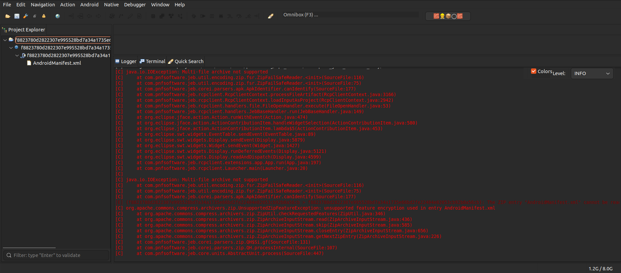
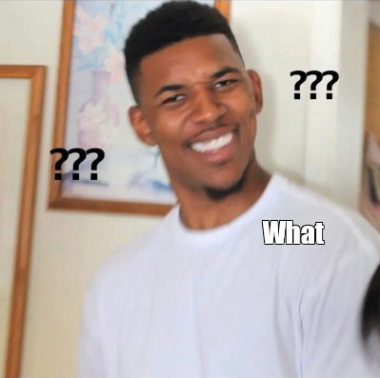

Evasion techniques
Sample failed to load in JEB Pro

Slide 14




Evasion techniques
Loaded in JEB Pro
2
Manifest
Loaded in jadx
+
Multi-disk fix
1
3
Processed in apktool
Long filenames
APK
Main payload

Slide 15
Evasion techniques: fixes
1
2
3
Multi-file
Android manifest
Files
2 parts
3 parts
1 part
6 evasions in total

Slide 16
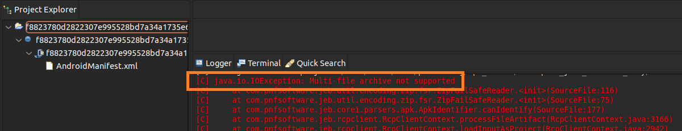
Evasion 1: Multi-Disk
Multi-file archive?

Slide 17
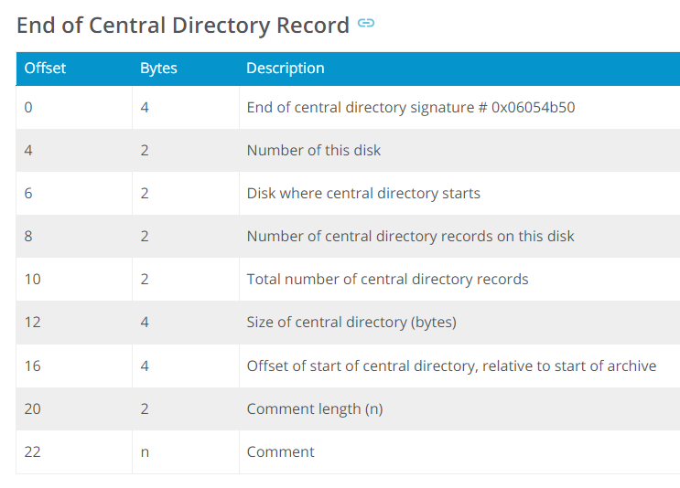
Evasion 1: Multi-Disk, p.1
End of Central Directory structure (EOCD)

Slide 18

Evasion 1: Multi-Disk, p.1
Disk number and the start of Central Directory

Slide 19
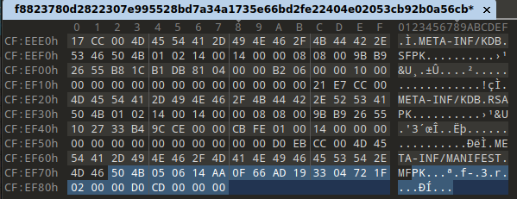
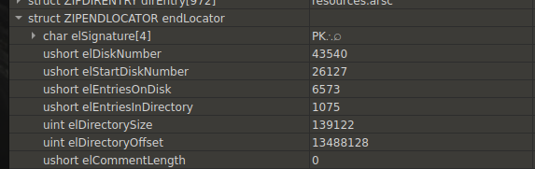
Evasion 1: Multi-Disk, p.1
Examine EOCD for
disk number and
CD start
Set both values to 0

Slide 20
Evasion 1: Multi-Disk, p.2
End of Central Directory structure (EOCD)

Slide 21
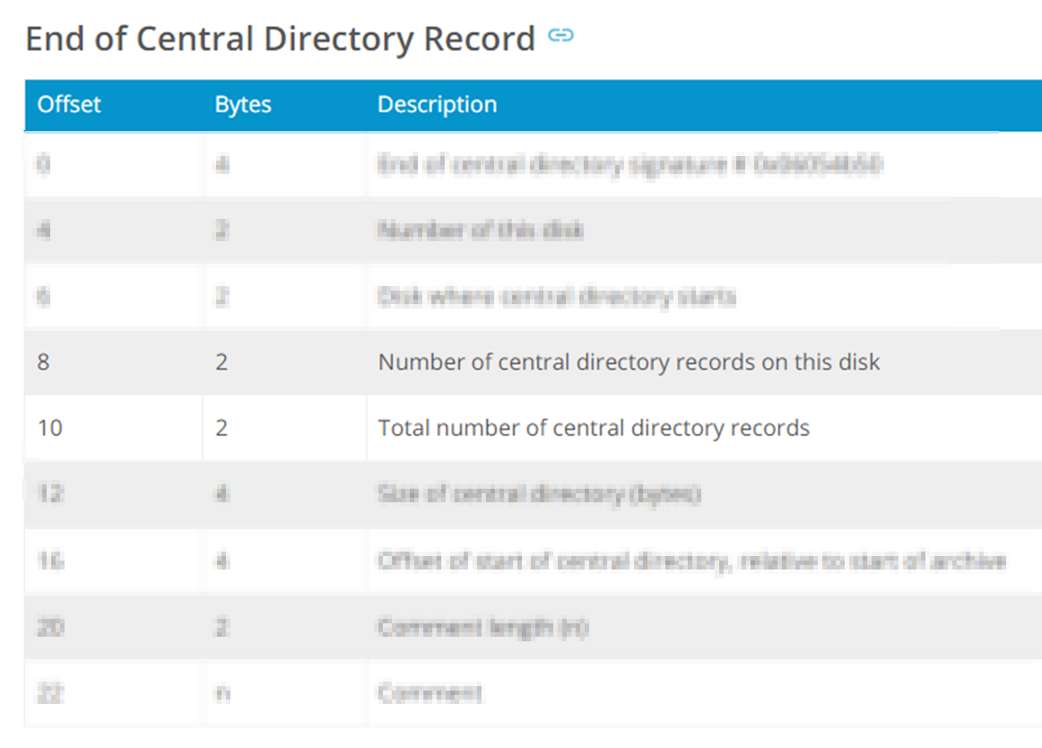
Evasion 1: Multi-Disk, p.2
Number of files in the archive

Slide 22
Evasion 1: Multi-Disk, p.2
Examine EOCD for entries on disk and
entries in directory
Values must be equal
Empirically stated:
1075 is the correct one

Slide 23
Evasion 1: Multi-Disk
EOCD fix summary
3 changed values
Set to 0
Set to 0
Set to 1075

Slide 24
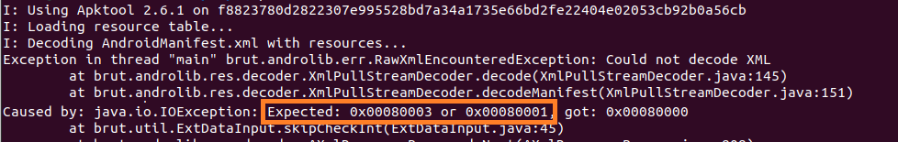
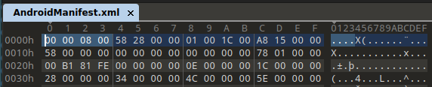
Evasion 2: AndroidManifest, p.1
Expected another value at the beginning of the manifest
0x00080000 is present

Slide 25

Evasion 2: AndroidManifest, p.1
Two values possible at the beginning of Manifest?
apktool source code constants

Slide 26
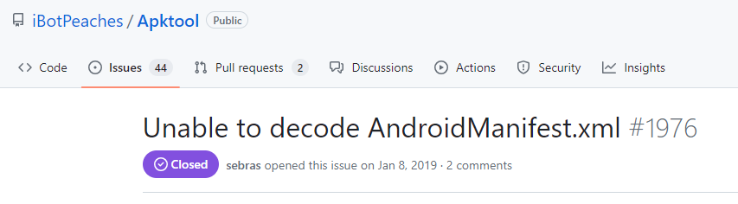
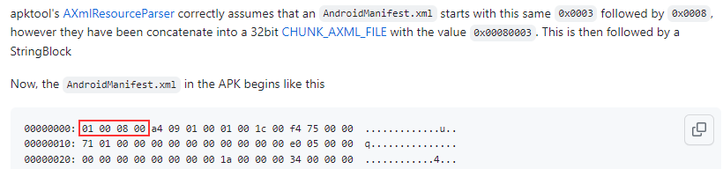
Evasion 2: AndroidManifest, p.1
0x00080003 is the correct value to be present

Slide 27
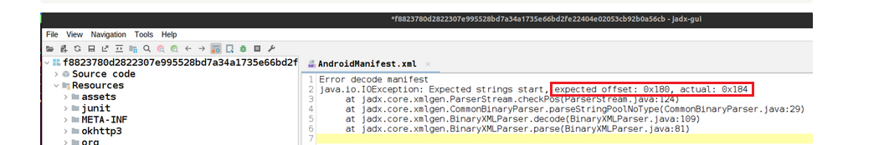
Evasion 2: AndroidManifest, p.2
Magic value fixed, but another exception is thrown
Unexpected start of the string

Slide 28
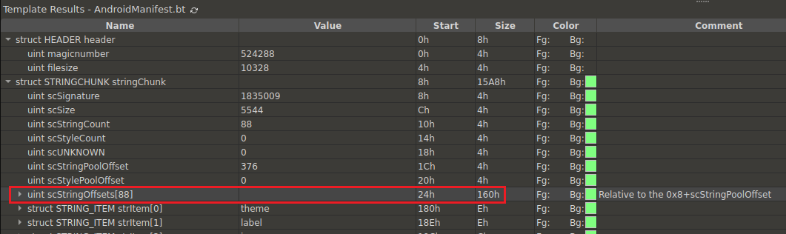
Evasion 2: AndroidManifest, p.2
The array where exception occurs

Slide 29
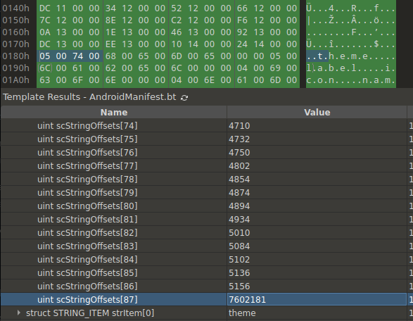
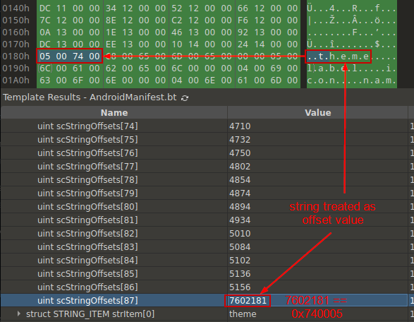
Evasion 2: AndroidManifest, p.2
scStringCount must be decreased by 1
Wrong data interpretation for the last offset

Slide 30
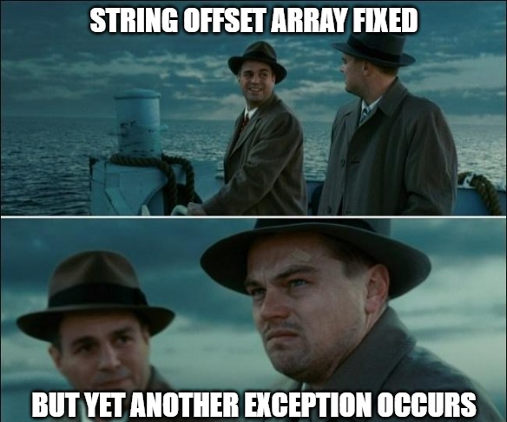
Evasion 2: AndroidManifest, p.3

Slide 31
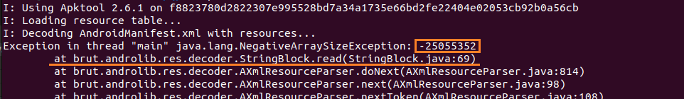
Evasion 2: AndroidManifest, p.3
Negative array size exception

Slide 32
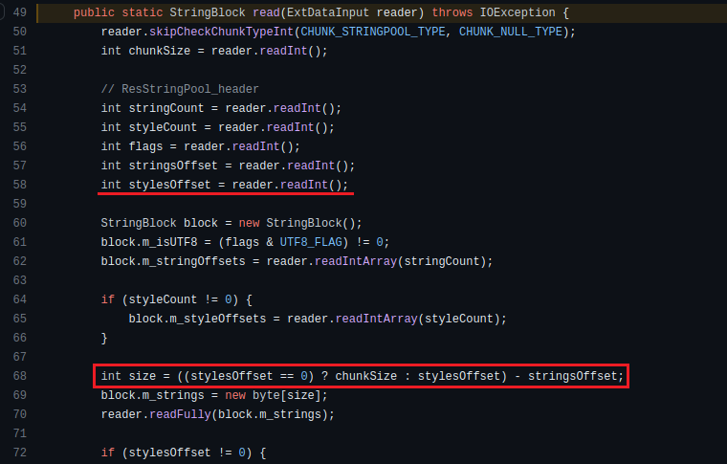
Evasion 2: AndroidManifest, p.3
read from the structure
exception occurs here
apktool source code: size of allocated array

Slide 33
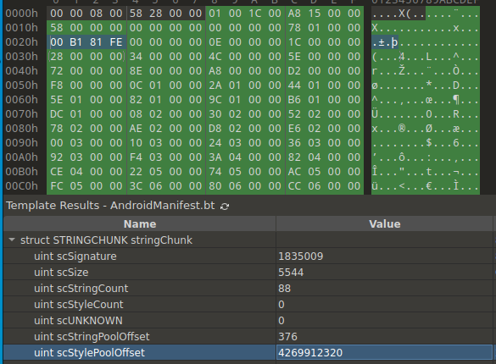

Evasion 2: AndroidManifest, p.3
No styles present
1
scStyleCount == 0
Why
2
scStylePoolOffset != 0 ?
Set it to 0 as well
1
2

Slide 34
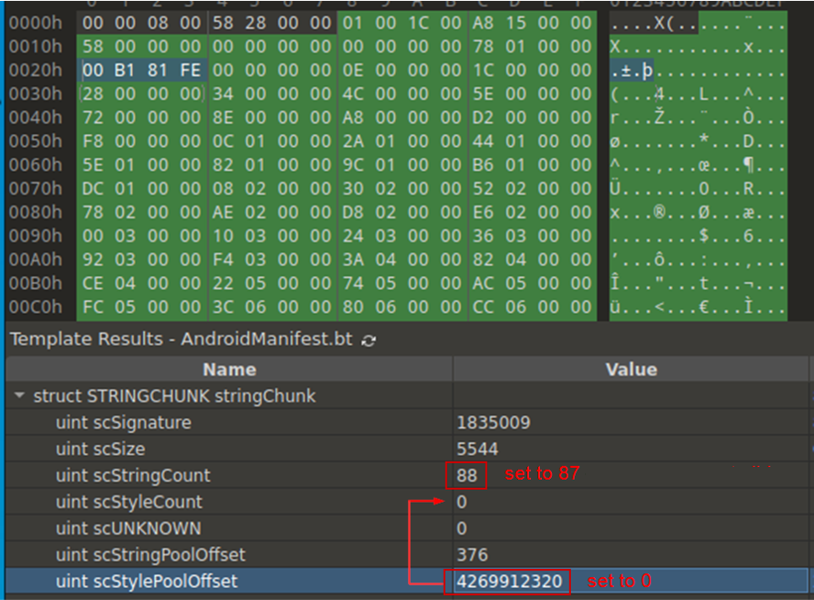
Evasion 2: AndroidManifest
Set magic number
Must be 0x80003
Change certain values
scStringCount
scStylePoolOffset

Slide 35
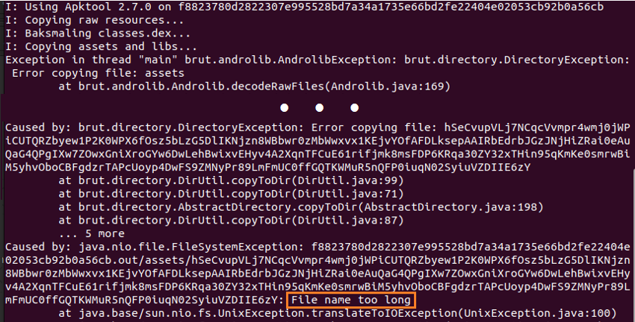
Evasion 3: Files
Files with paths of more than 260 characters

Slide 36
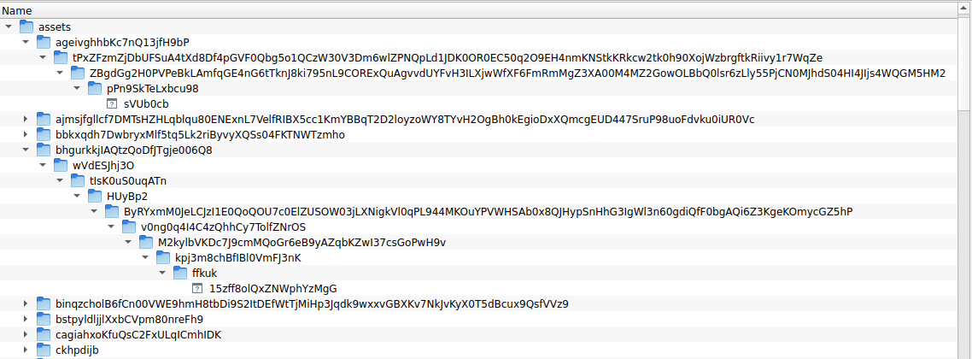
Evasion 3: Files
Files with paths of more than 260 characters

Slide 37
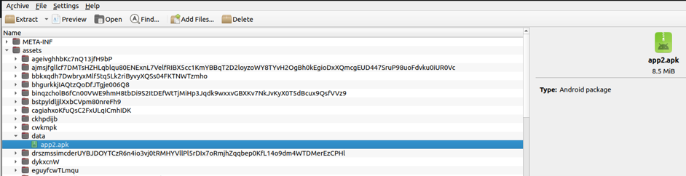
Evasion 3: Files
APK payload inside is stored via a shorter (normal) path

Slide 38
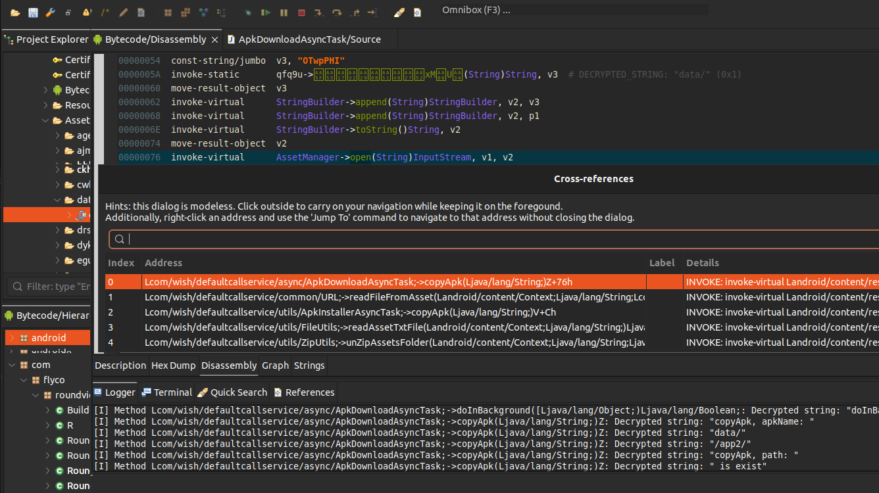
Evasion 3: Files
1
AssetManager->Open
2
3
No references for long paths found: delete the files

Slide 39

Evasions mitigated
Notes:
Different samples contain different functionality, not all in one

Slide 40
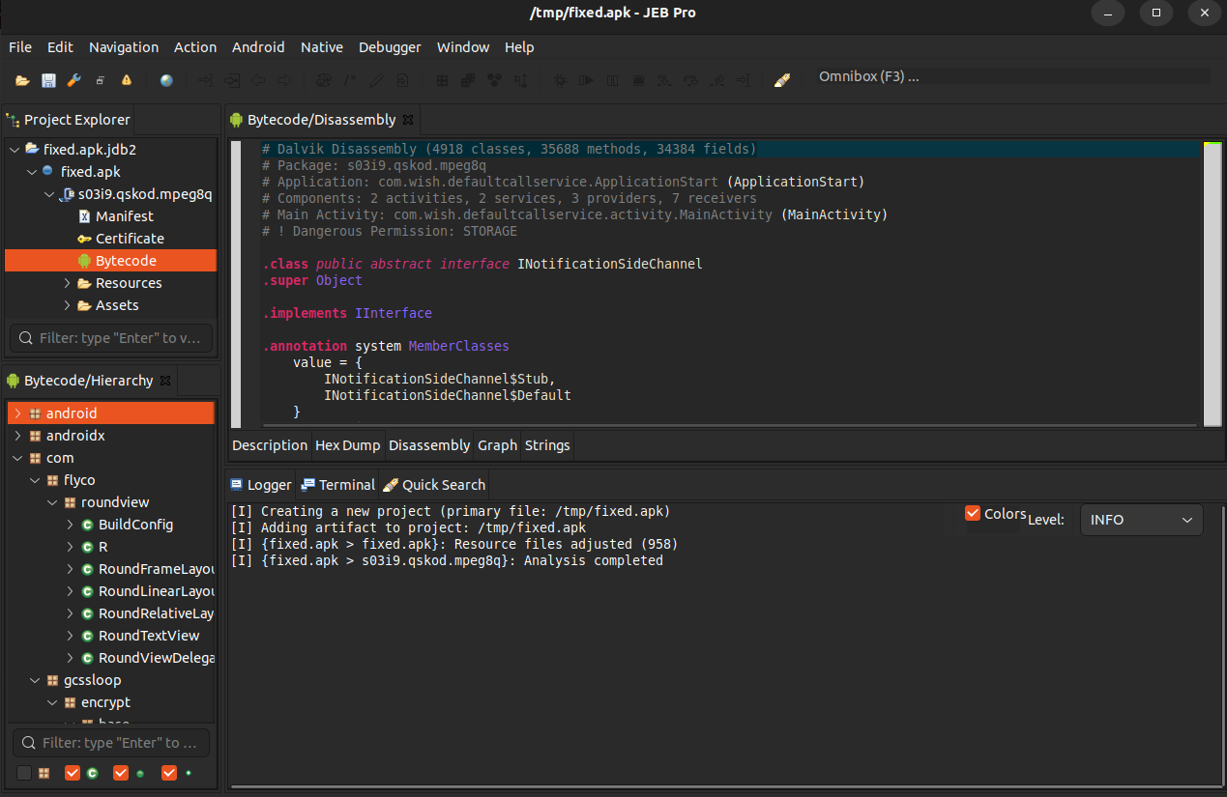
Evasions mitigated
Sample successfully loaded in JEB Pro
Notes:
Different samples contain different functionality, not all in one

Slide 41
Functionality cherry-picks
4
Notes:
Different samples contain different functionality, not all in one

Slide 42
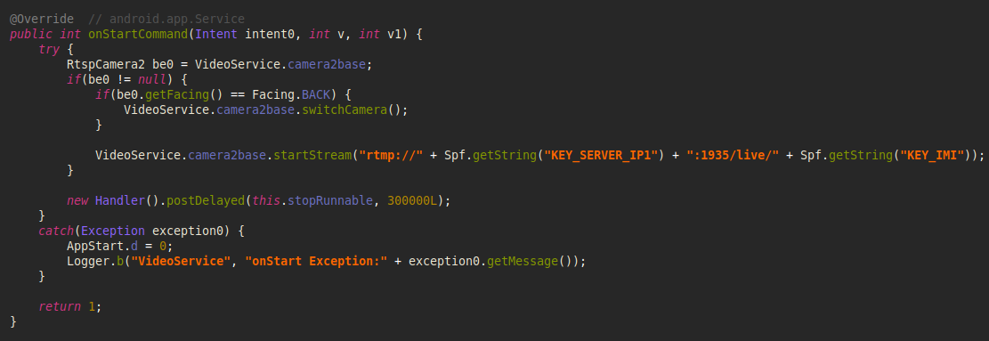
Live streaming
Both frontal and back cameras can be streamed

Slide 43





Network communication
Drop dead resolvers
GoogleDrive
FakeCalls makes a
request to a web server
Real C&C servers
are obtained
Filename or contents
decrypted
Alternative server
Notes:
One sample refers either to GoogleDrive or to the alternative server

Slide 44

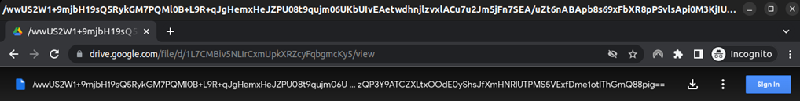
Network communication
AES
SERVER1_156.245.21.38-SERVER2_156.245.12.211-SERVER3_154.38.113.162-
SERVER4_154.197.48.72-SERVER5_154.197.48.125-SERVER6_154.197.48.195-
SERVER7_206.119.82.78-SERVER8_154.23.182.63-SERVER9_154.197.48.93-
SERVER10_154.197.48.212-SERVERLK_127.0.0.1

Slide 45

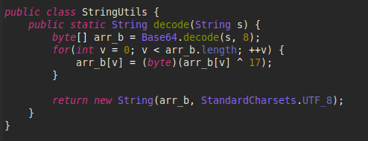
Network communication
$ curl https://www.daebak222.com/huhu/admin.txt {
"a01": "eWVlYWIrPj5mZmY_dXB0c3B6IyMjP3J-fA==",
"b05": "Y2ViYWIrPj4gICI_IyAjPykpPyAlKSspIiMjPn14Z3Q=",
"a07": "eWVlYWIrPj4gKSM_ICc_JSM_ICkrJCEkJD55ZHlkPnB1fHh_P2VpZQ==“
}
$ curl https://www.daebak222.com/huhu/admin.txt {
"a01": "eWVlYWIrPj5mZmY_dXB0c3B6IyMjP3J-fA==",
"b05": "Y2ViYWIrPj4gICI_IyAjPykpPyAlKSspIiMjPn14Z3Q=",
"a07": "eWVlYWIrPj4gKSM_ICc_JSM_ICkrJCEkJD55ZHlkPnB1fHh_P2VpZQ==“
}
C&C server
Server for streamed videos
New drop dead resolver
https://www.daebak222.com
rtmp://113.212.88.148:8322/live https://182.16.42.18:5055/huhu/admin.txt

Slide 46
Conclusion
Notes:
Different samples contain different functionality, not all in one

Slide 47
Summary
Growing market to operate in: tricks work
~ 600 million USD loss in 2020
170,000 victims from 2016 to 2020
20+ financial institutions in South Korea mimicked
chosen among largest organizations in the industry
Multiple anti-analysis techniques; stealing capabilities
High potential for significant damage to victims

Slide 48
Links
National Police Agency. Status of voice phishing
https://www.data.go.kr/data/15063815/fileData.do
Damage of 1.7 trillion won over the past 5 years (as of 2020)
https://it.chosun.com/site/data/html_dir/2020/09/28/2020092802480.html
Kaspersky’s research of FakeCalls:
https://www.kaspersky.com/blog/fakecalls-banking-trojan/44072/
Check Point’s research of FakeCalls:
https://research.checkpoint.com/2023/south-korean-android-banking-menace-fakecalls/

Slide 49
Thank you for the attention!
Contact us:
bmelnykov@checkpoint.com
ramanl@checkpoint.com

