Slide 1

Supercharge Your Malware Analysis Workflow
Notes:
Hi everyone,
My name is Kevin Hardy-Cooper, I’m the dynamic analysis lead for the Assemblyline project at CSE. I’m here today to give you a little overview on what Assemblyline is and how you can use it from the comfort of your desk.

Slide 2
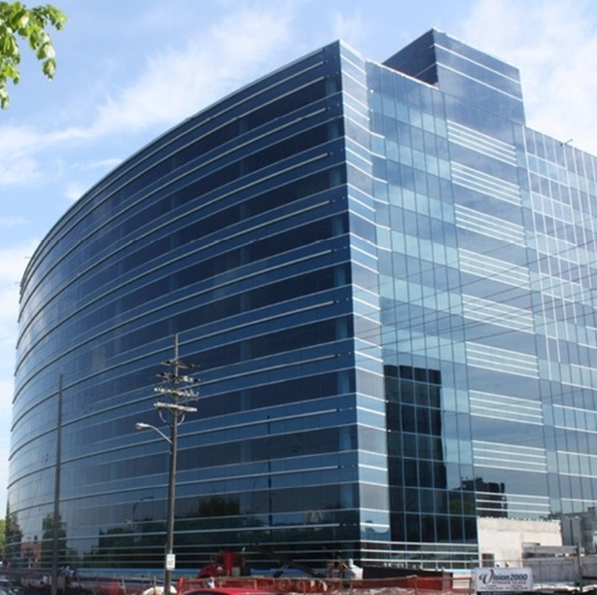






Canadian Centre for Cyber Security
It is the single unified source of expert advice, guidance, services and support on cyber security for Canadians.
Critical Infrastructure
Cyber incident cases
2000+ cases a year
Federal Host-based Sensor
102 federal institutions (900000 endpoints)
Federal Network-based Sensor
84 federal institutions
Federal Cloud-based Sensor
80 federal institutions

Slide 3

What is AssemblyLine?
Scalable file analysis system
Automated analysis for Incident Detection & Response Teams
Easily integrated into existing ecosystems
Released to open-source on Oct.19, 2017!
Version 4 released in 2020
We help to Integrate, Scale & Maintain the community’s tools with CCCS’ operational knowledge
Notes:
Let’s start with the basics, what is Assemblyline?
Assemblyline is a scalable file analysis system that was designed to scan millions of files per day.
It was designed to automate analysis for incident detection and response teams.
It is designed in a way where it can easily integrate with existing ecosystems by exposing a comprehensive API and by giving you the ability to wrap your own set of tools into services for the platform.
Assemblyline was release to open-source in Oct 2017 and the current version that is available, version 4, was first released in 2020.

Slide 4








File analysis operations
Commercial + CSE rules
Antivirus
Sandboxes
Security products
Email
Alerts
Gateways
Automatic tasking via Webhook / API
50+ open-source and proprietary services
Generates a report, score, heuristics, tags
Recursively analyzes embedded elements
Indicators Of Compromise (IOC)
EDR
Analyst / IR / FORENSIC
Notes:
Here’s the 10-thousand foot view of how Malware Cyber is processing files.
It first starts by gathering files for Assembylline to scan, these files come from our various sources that we have. These can include automated threat feed analysis, partners submitting single files manually or using scripts to automatically submit predetermined sets of files through our APIs.
Once the file gets in, Assemblyline will look at each file type and will send the file to the appropriate service out of our 50+ open-source services but in the case of "Malware Cyber", the file will also be sent to a few proprietary services as well, services that could not be shared with the open-source community.
For services that have external rulesets, Yara, Suricata and Sigma to name a few, Assemblyline will pull the rules from the commercial and proprietary feeds that we have configured and run those different rules on the files that were submitted.
Assemblyline will also send your file to the different AV products that we own, send the file to our dynamic analysis farm built on top of CAPE and any other security product that we’ve configured.
Results for each service will be aggregated, tags will be generated, and a final score will be computed for each file. Assemblyline will recursively analyze the files that it found during analysis.
After this is all done, Alerts can be generated in the system if the originator has chosen to do so, indicators of compromise will be brought forward to the user and Assemblyline will then pass on the results to another system for the IOCs to be analyzed and actioned.

Slide 5
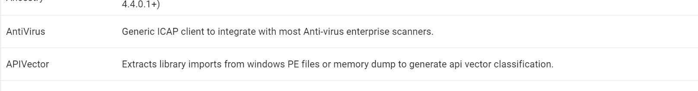







Assemblyline’s stack
50+ analyzers
Core
||

Slide 6

Demo
Notes:
Enough slides, let's see this thing in action
Submission Notes:
484fgtWl31FuQkGY53ew8D
Overview: Email contains Excel files that runs VBA macros that deploys ransomware
Email facade: Sender claims to be applying for a job application by providing their resume
Spreadsheet translation: “Please activate the editing function to display the competency profile. Loading...”
13S6ufhkXVvChI7dco1imk
Overview: Obfuscated batch script

Slide 7
Retrohunting with HauntedHouse
A lot of inspiration taken from CERT.PL’s mquery & UrsaDB
Key differences
  Kubernetes/Cloud-native
  Rust-based rather than Python
  Operates on rolling datasets
  Built with access control in mind
Integration with Assemblyline supported
  Searches can be performed on-premise without sharing to third-party platforms
  Statistics are generated to track your rule’s progress over time
  CybercentreCanada/haunted-house (github.com)

Slide 8
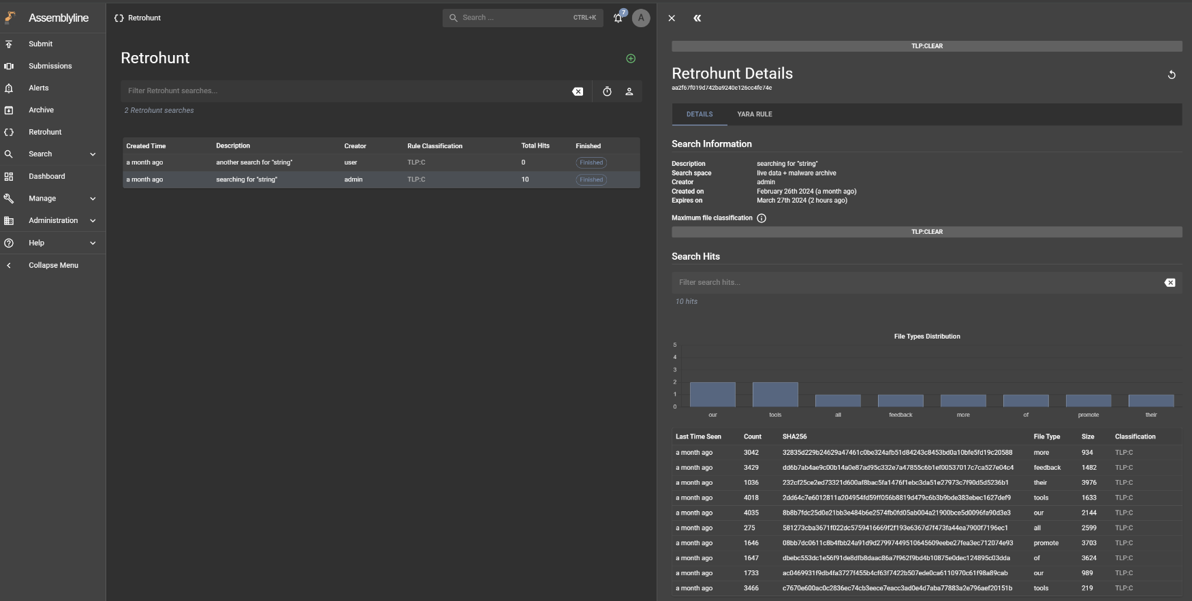
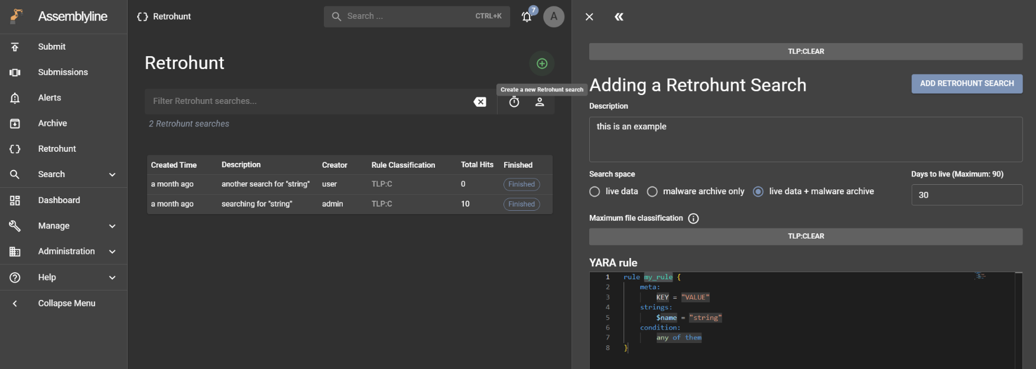
Retrohunt Interface

Slide 9
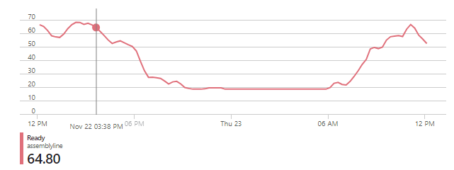
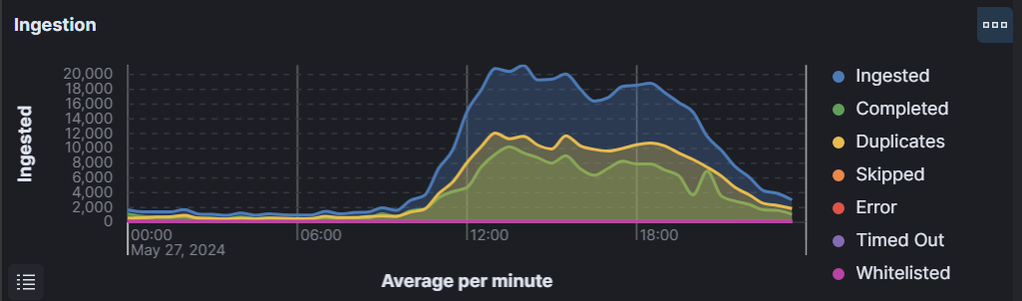
Our current biggest deployment
Auto-scalable Kubernetes cluster hosted in the cloud! ☁️
14M+ files received to scan per day
  Up to 7M+ unique
Lots of downtime during the night
Rarely uses the full node capacity
Mixed file types, mix of static and dynamic analysis.

Slide 10
Internet is down?
No problem just use the slides!
Notes:
Sample of choice for demo: 1b61b16dd4b7f6203d742b47411ca679f1f5734ed01534a37a126263f84396c0

Slide 11
Let’s introduce some key concepts
Notes:
Sample of choice for demo: 1b61b16dd4b7f6203d742b47411ca679f1f5734ed01534a37a126263f84396c0

Slide 12
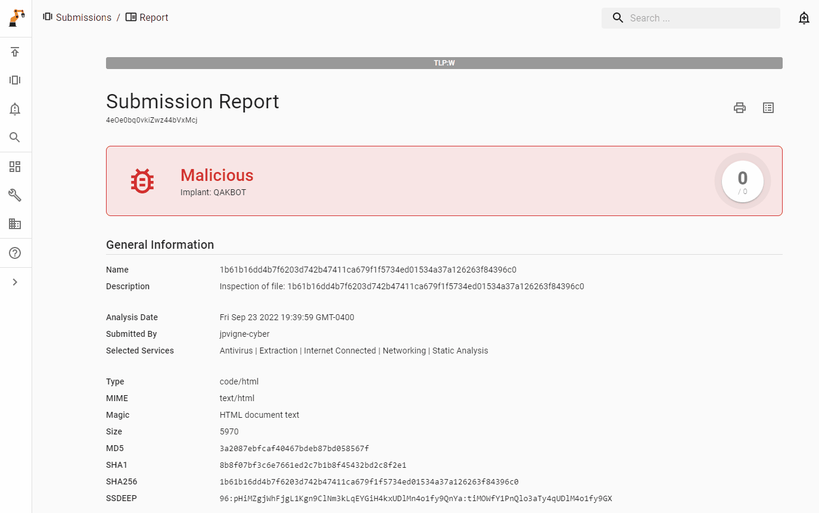
Report
The TL;DR
System’s verdict
Attribution from Yara rules
All the highlights
Indicators of compromise
Printable!
Notes:
Sample of choice for demo: 1b61b16dd4b7f6203d742b47411ca679f1f5734ed01534a37a126263f84396c0
This view is the submission report for the analysis of the initial file and any extracted files that followed.
This view contains a summary of the highlights from the analysis and sub-analyses, Assemblyline’s verdict on this submission, attribution from Yara rules or configuration extractors, and indicators of compromise. This view is also printable.

Slide 13
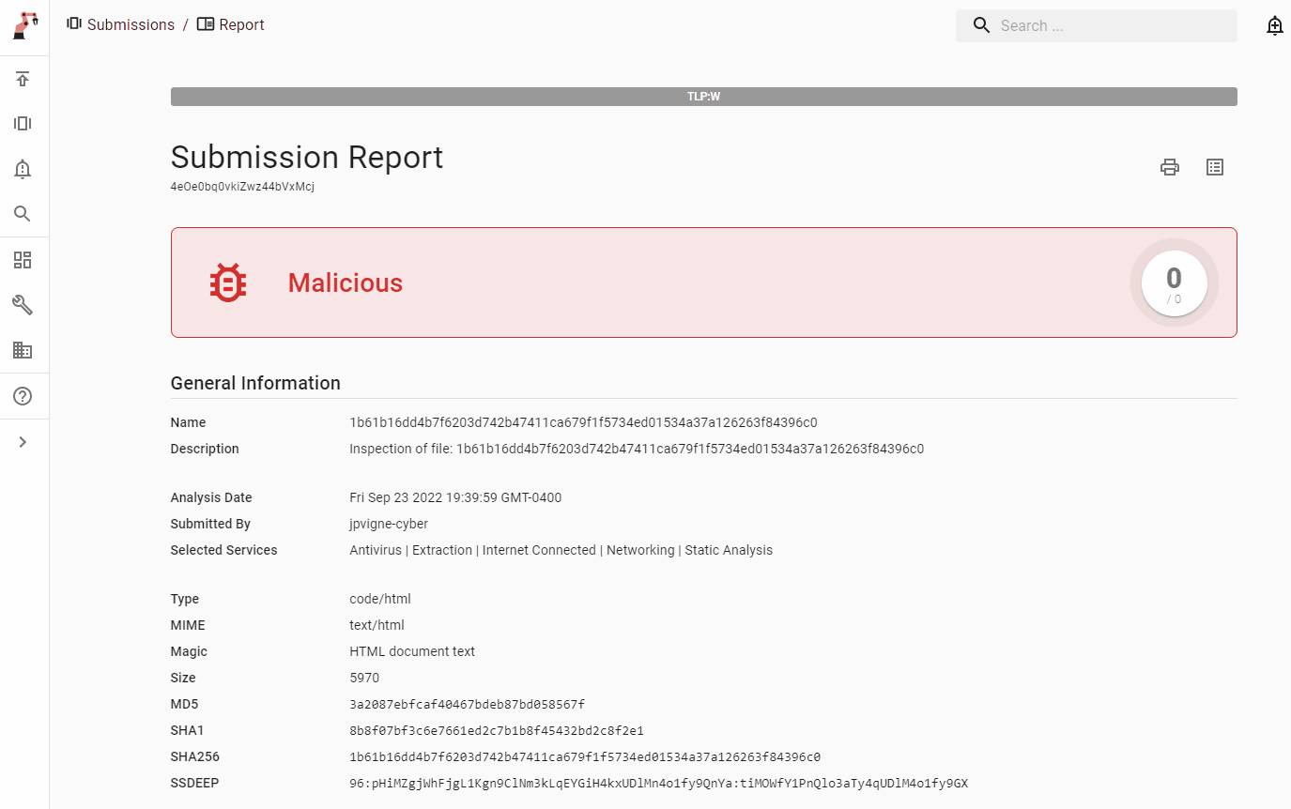
Heuristics
Highlights of malicious elements
Determine the score of a file
Associated IoCs inherit their maliciousness level
Searchable
Notes:
Sample of choice for demo: 1b61b16dd4b7f6203d742b47411ca679f1f5734ed01534a37a126263f84396c0
Heuristics in Assemblyline are interesting elements from an analysis of a file. Depending on how interesting an element is, a score is associated with that heuristic, and these scores can compound to determine a verdict for the submission (malicious, suspicious, informational). Indicators of compromise associated with a heuristic inherit the maliciousness level. Heuristics are searchable in Assemblyline, and you can pivot off of them to see other submissions that contain the same heuristics.

Slide 14
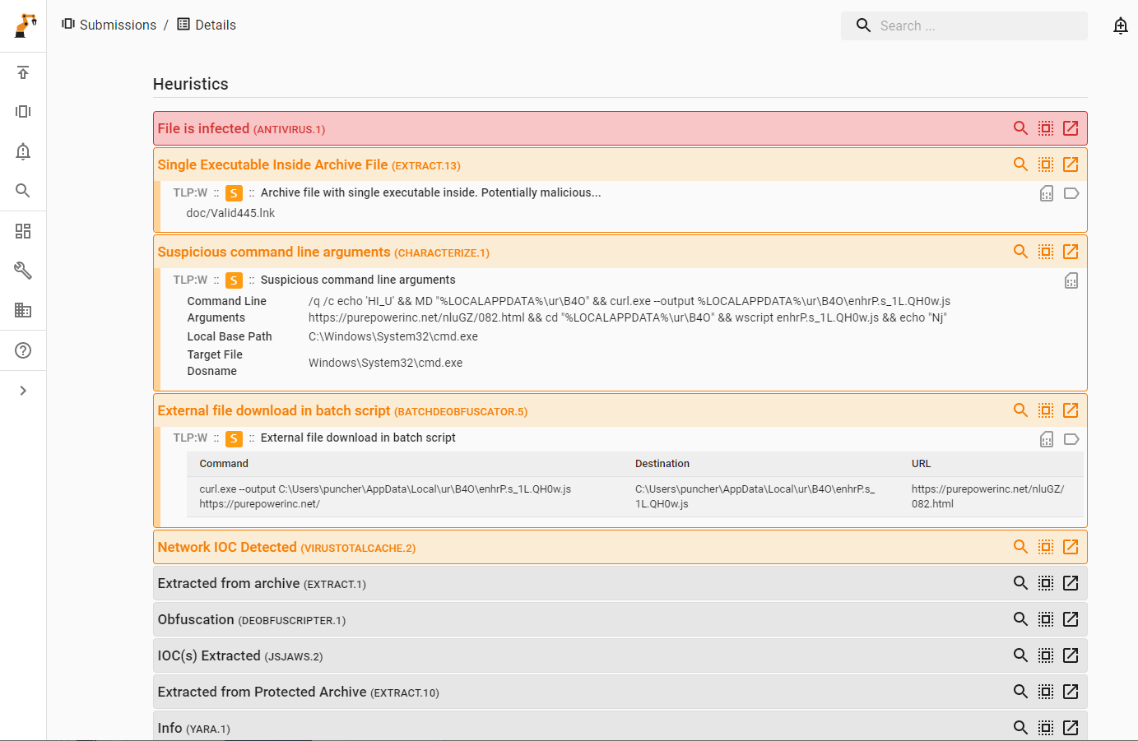
Heuristic highlights
Id
Name
Description
Details
Color coded
Notes:
Sample of choice for demo: 1b61b16dd4b7f6203d742b47411ca679f1f5734ed01534a37a126263f84396c0

Slide 15
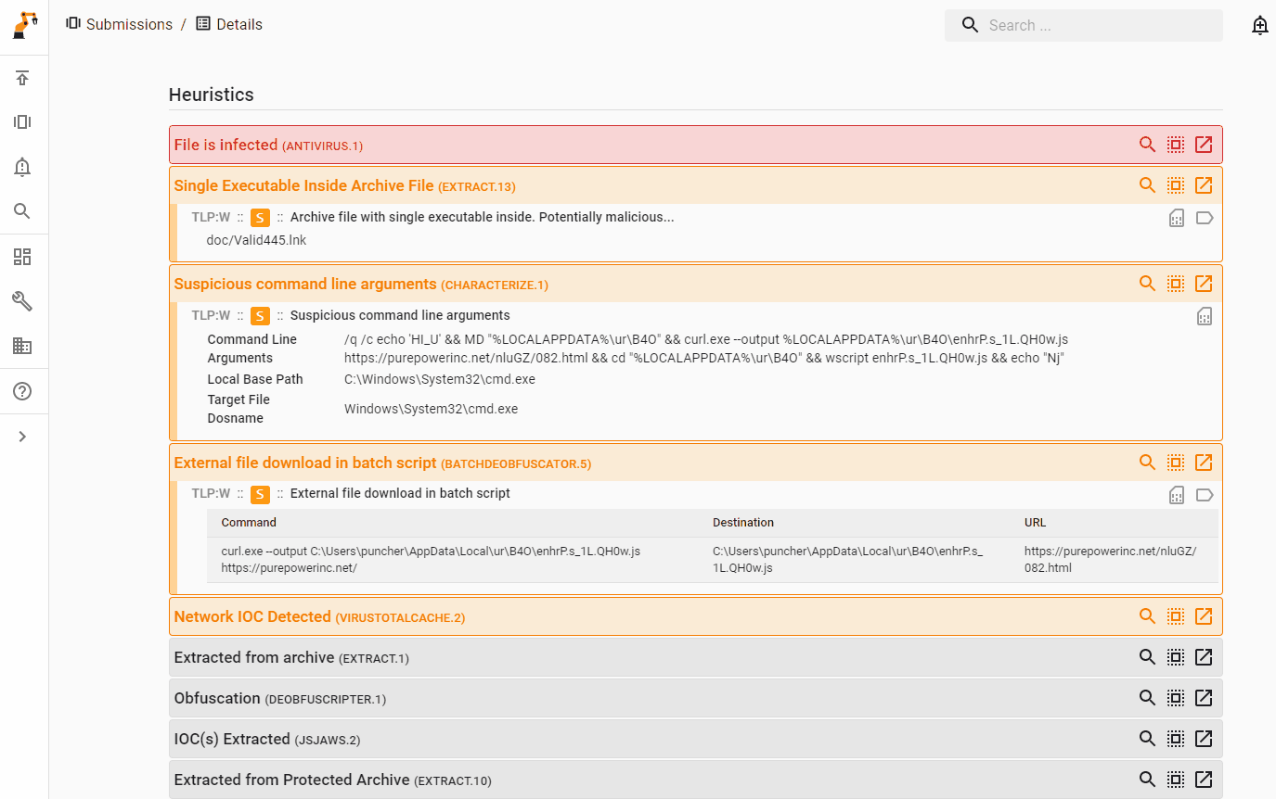
Tags
Extracted data
Typed
Searchable
E.g.:
  Domain
  URL
  Function name
  Signature
  Fingerprint
Notes:
Sample of choice for demo: 1b61b16dd4b7f6203d742b47411ca679f1f5734ed01534a37a126263f84396c0
Tags are extracted data from an analysis that are associated with a heuristic.
For example, in the above screenshot, the heuristic “External file download in batch script” has the URI tagged with it. Tags, like heuristics, allow pivoting, and you can search for all analyses that contain a specific tag. Tags are typed and can represent a variety of data such as domains, URIs, Ips, portable executable function names, signatures and fingerprints.

Slide 16
How was the analysis performed?

Slide 17
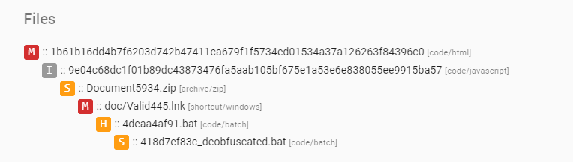
File Analysis (recursively)
Embedded elements are resubmitted
Services used for analysis will depend on file type
code/html > code/javascript > archive/zip > shortcut/windows > code/batch
Notes:
RECURSIVE FILE ANALYSIS
Assemblyline analyzes files recursively, as in embedded elements are resubmitted. Services used for analysis will depend on the file type. The example seen below is the file tree for the malware sample, and you can see the benefits of recursive file analysis and variety of services:
code/html > code/javascript > archive/zip > shortcut/windows > code/batch

Slide 18
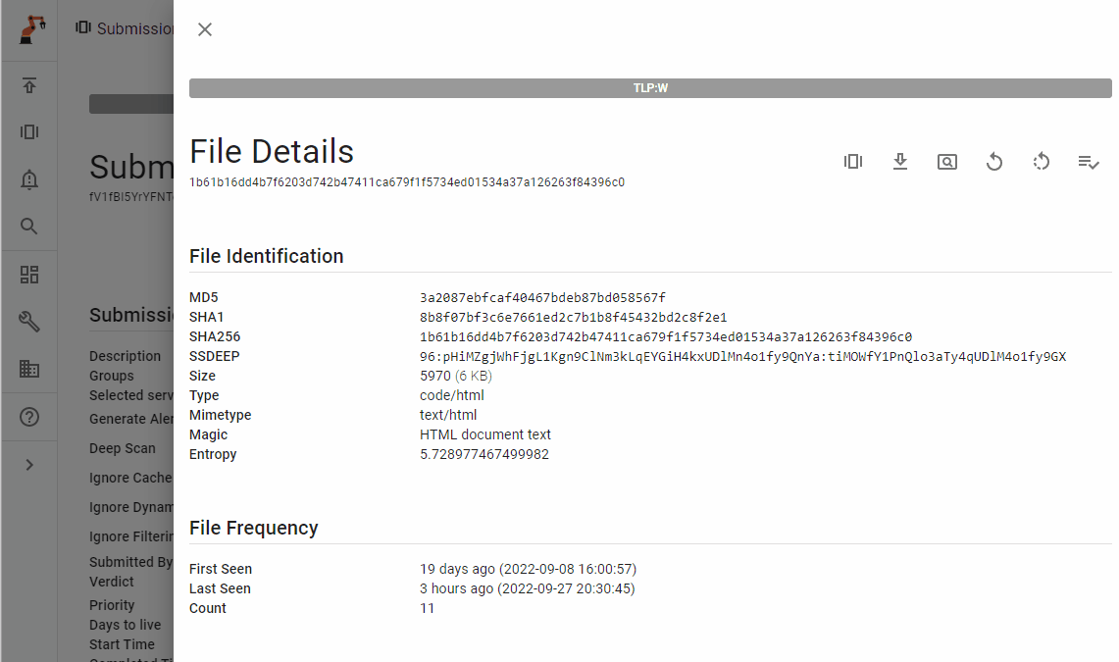
File details
code/html > code/javascript > archive/zip > shortcut/windows > code/batch
Hashes
Type
# Times seen
Analyst can download file safely in the CART format
File viewer
  Content
  Strings
  Hex
Notes:
When viewing the file details page for the initial HTML file, you can see the hashes for that file, the file type, the number of times that this file has been seen in this Assemblyline instance, a preview of the file if render-able, and the entropy. An analyst can download the file safely in the CaRT format if configured.
An analyst can view the file contents in the ASCII viewer.
It should be noted that this HTML file is used for phishing and contains a password for an embedded file in plaintext: U523.
A feature that was recently added was the ability to use artificial intelligence to summarize the behaviour of scripts.
The summary hits the nail on the head. This is a malicious script disguised as an HTML document that downloads a ZIP file to disk. Keep in mind that the malicious JavaScript in this file is heavily obfuscated, so this summary is very impressive.
An analyst can also explore the file contents with the HEX viewer:.

Slide 19
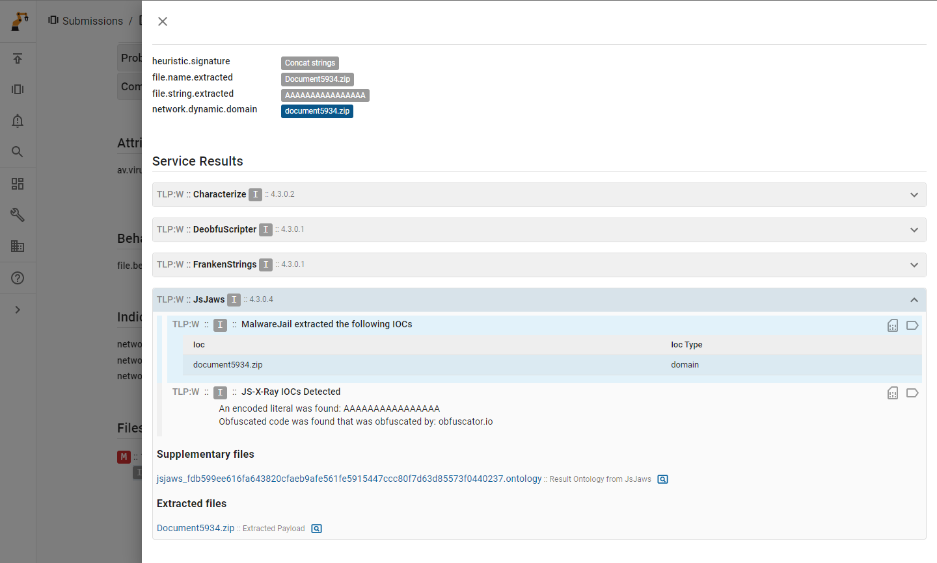
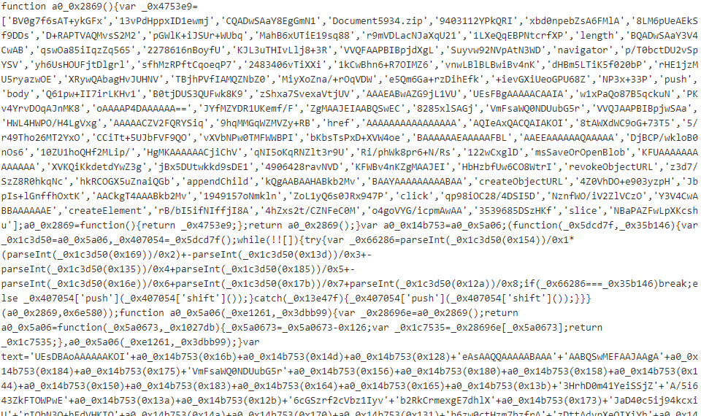
File details
code/html > code/javascript > archive/zip > shortcut/windows > code/batch
Service: JsJaws
JavaScript emulator
Deobfuscated the JavaScript and extracted a zip file!
Notes:
A exceptionally popular vector that the Government of Canada receives as phishing attachments is HTML files. To combat this, we developed the JsJaws (or JsMachoir) service, which uses a variety of open-source tools to detect malicious JavaScript. Two emulators are used (Box.js and MalwareJail), one abstract syntax tree tool (JS-X-Ray), a signature set that runs on both file contents and emulator output, and a few other tools.
Looking at the above service analysis output from JsJaws for this HTML file, the emulator was able to emulate the file to the point where a ZIP file was written to disk, and this file is then resubmitted to Assemblyline for analysis.

Slide 20
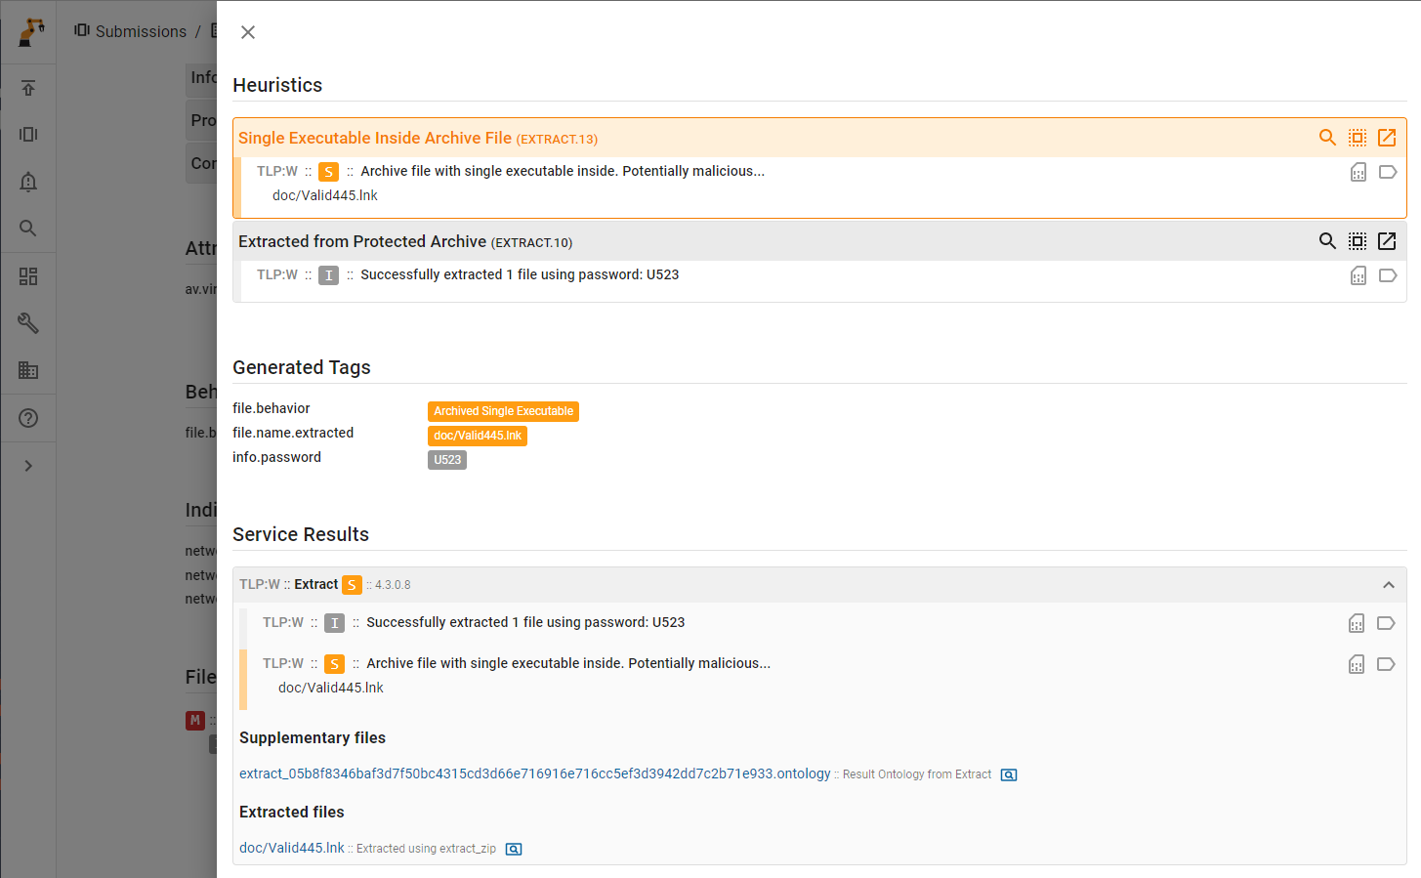
File details
code/html > code/javascript > archive/zip > shortcut/windows > code/batch
Service: Extract
ZIP, ISO, VHD, HTML, RAR, GZ & many others
Extract leveraged word list passed from previous services for password guessing!
Remember that html? ☺
Notes:
The Extract service receives this archive file and leverages a word list passed from previous services in the extraction tree for password guessing. Using the correct password from the HTML file, the contents of the ZIP file were successfully extracted. The LNK within this ZIP is then resubmitted to Assemblyline for analysis.

Slide 21
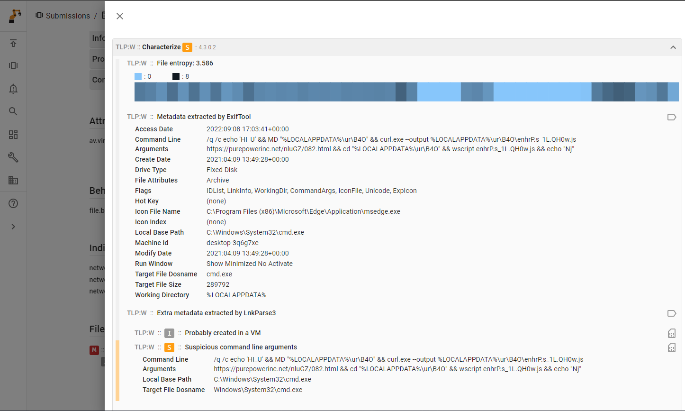
File details
code/html > code/javascript > archive/zip > shortcut/windows > code/batch
Service: Characterize
Analyze metadata & entropy & lnk files
This lnk file “borrows” MS Edge icon…
We extracted some Windows commands!
Notes:
The Characterize service receives this Windows shortcut file and analyzes this file using the Exiftool and the LnkParse3 tool. This malicious LNK file “borrows” the Microsoft Edge icon to fool the user, and we were able to extract Windows commands that would have been run on the victim’s computer. These Windows commands get written to a batch file and that file gets resubmitted to Assemblyline for further analysis.

Slide 22
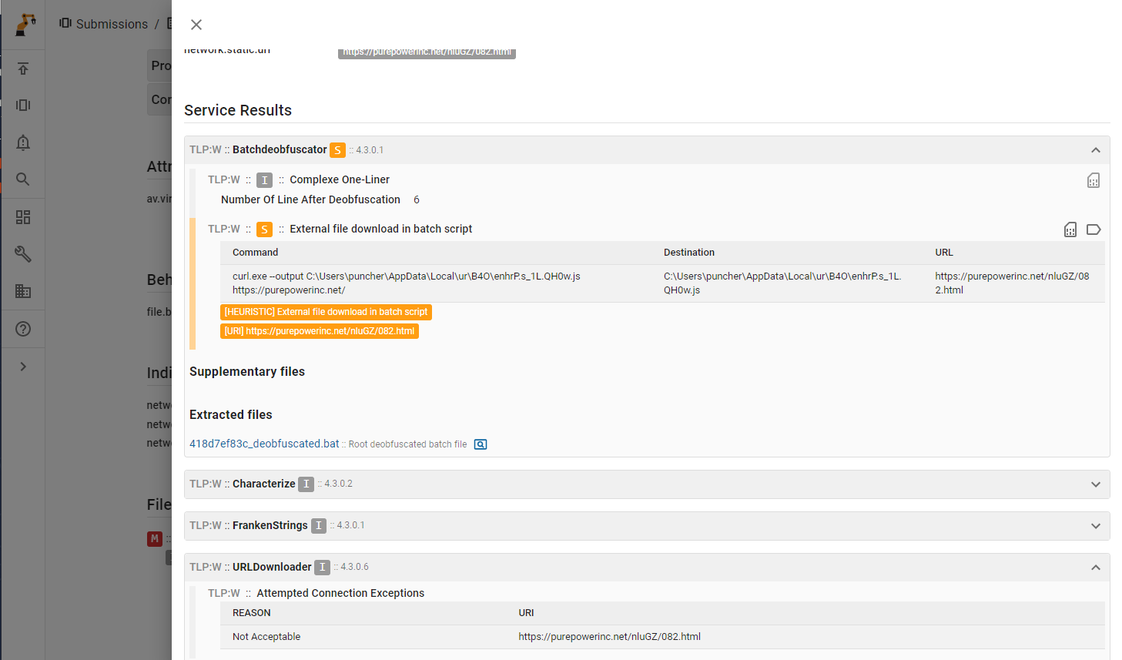
File details
code/html > code/javascript > archive/zip > shortcut/windows > code/batch
Service: Batchdeobfuscator
Deobfuscate & parse batch file
Score suspicious execution
We also have a new service which will attempt to fetch suspicious URLs
We can finally flag this URL as suspicious!
Notes:
The service that is tailored for batch files is called Batchdeobfuscator, and this service deobfuscates and parses batch files. This service recognizes that an external file was downloaded to disk, raised a heuristic, tagged the URI, and flagged this heuristic and URI as suspicious.
Since the majority of files that Assemblyline receives are benign, it cannot download every file from every URL that it sees, so URLs to be downloaded must be flagged as suspicious or malicious.

Slide 23

Wonder what a little bit of REST API magic could do?

Slide 24
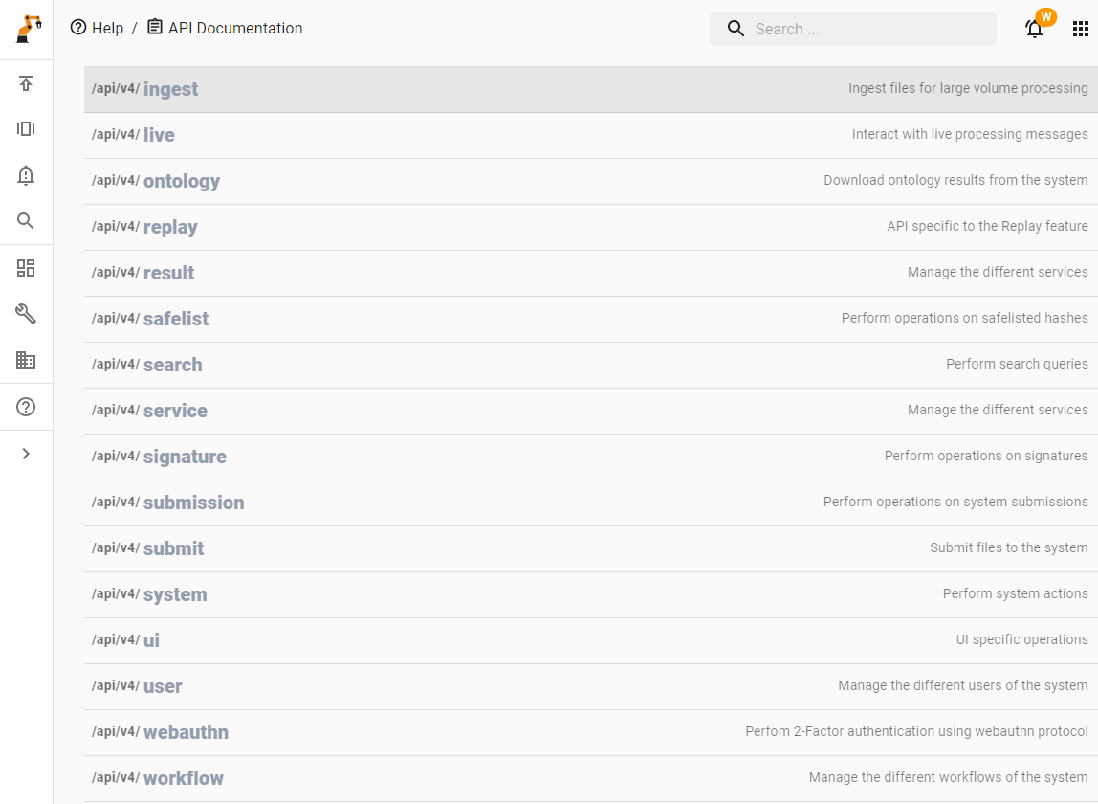
Powerful REST API
Submission
Searches
Data mining
Automation
Notes:
Assemblyline also includes a powerful REST API which can be used for submissions, searching, data mining, and automation.
Here are a few examples of how the CCCS uses the REST API to perform critic functions:
The “ingest” API is used by EDR tools across the Government of Canada’s to send millions of files a day to Assemblyline, including with each file information about the host where that file was collected from, timestamps, and file system data.
The “ontology” API is used to harvest the generated data in a flat format from Assemblyline for each file and store it in a relational database such that big data analytics can be used.
The reverse engineering team uses the “ingest” API to send new files to Assemblyline that hit their future hunts on malware database services like VirusTotal and Malware Bazaar, such that they can analyze how their configuration extractors perform against the latest public samples.
The “replay” API is used to send submissions of interest from a low-side system to a high-side system for further analytics, preserving the submission across the system.

Slide 25
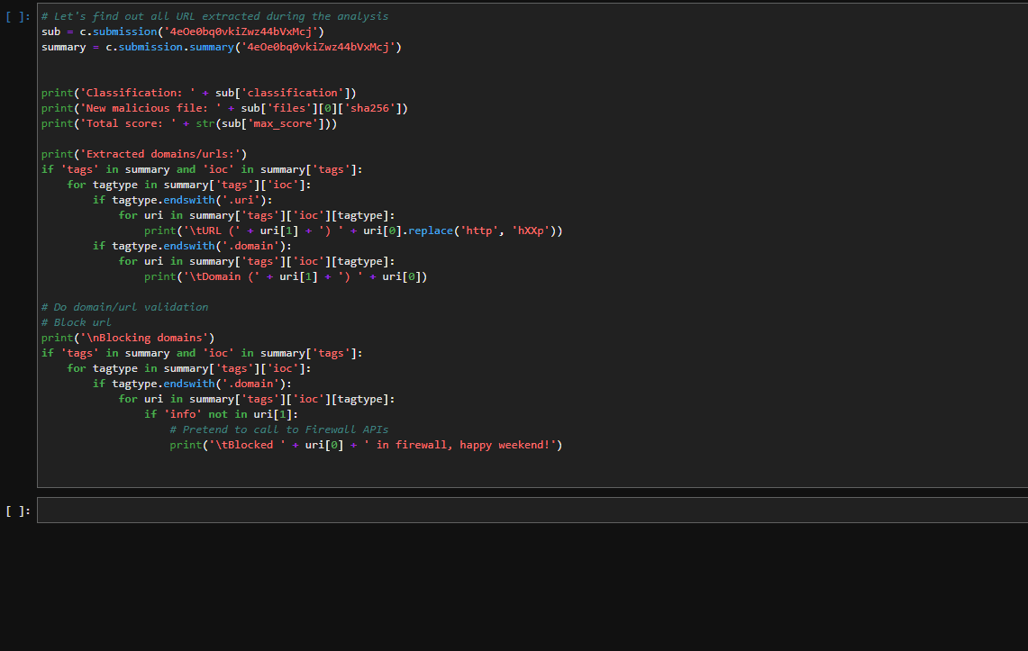

Slide 26
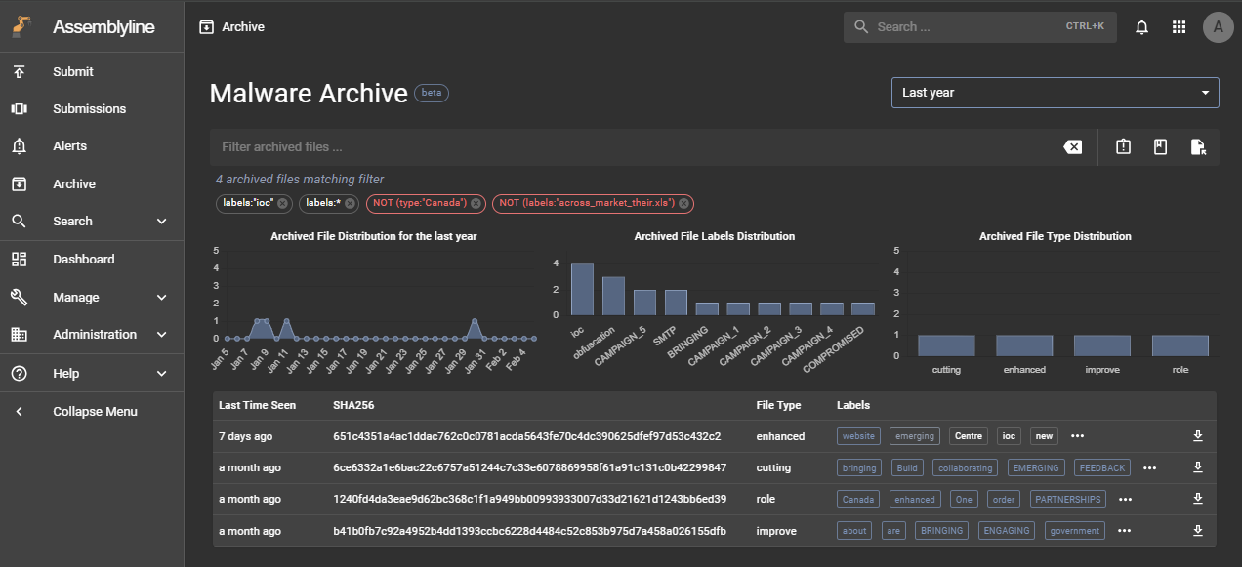
Malware Archive
TODO
Notes:
Assemblyline was initially designed to never store data forever. This was due to the large throughput of data that it receives and generates, and the guiding principle that alerts should be triaged as soon as possible, therefore there is no need to store files for longer than a few months.
The CCCS is increasingly moving towards big data analytics, which has created the requirement to store some data forever. With this requirement, the Assemblyline team has developed the “Malware Archive” concept, which is basically a feature that allows you to store submissions forever in the system.
The most interesting aspects of this capability is that when you are viewing a submission that has been retained forever in the Malware Archive, you can view “relations” between files in the system (archived and non-archived) and “community” feedback about the file.
Relations could be attributions, labels, or file types for files that match a given query in the archive. Community feedback can be viewed per submission, where users can add labels and comments, which subsequently can be searchable in the archive view.

Slide 27


Questions?
Contact us:
assemblyline@cyber.gc.ca
Notes:
That’s it. If you have any questions, now is the time. Otherwise you have our contact information here. Thank you.
Backup Questions:
What’s the highest throughput you’ve seen from a deployment of Assemblyline?
We’ve seen processing as high as ~10M files per day, we’re actively looking to increase that number with starting to migrate some our core components to use Rust to facilitate direct interaction rather than using Redis as a message broker for internal communications
Are there any other open-source projects by the CCCS?
Howler: allows analysts to triage hits and alerts
Borealis: an enrichment API for IOC lookups (integration with AL supported)
Tools: CCCS-Yara, MACO, configextractor-py
Is there anything to look forward to in the coming year?
Rust migration as mentioned earlier to increase system performance
Submission Profiles: An easier way to onboard users by using pre-defined submission profiles
Malware Archive Evolution: clustering, custom tags/labels, user-supplied supplementary files

