Slide 1
Office bugs on the rise
Gabor Szappanos

Slide 2
Executive summary
We see more Office document exploit attacks than ever
Office documents are good for malware delivery
  …even better with exploits
It was never this easy to access Office exploits
  …and the criminals are well aware of that
  …but they still can’t work with the exploits themselves
Everything we observe is driven by the exploit builders

Slide 3
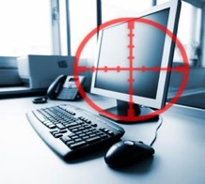


The story of malicious Office documents
1994-2003ish: the era of macro viruses
2003-2013: age of blissful ignorance (APT)
2013-2017: cybercrime (1st gen builders)
2017- : cybercrime (next gen builders)
Notes:
The first public release of MWI was in May 2013.
https://www.fireeye.com/blog/threat-research/2015/04/a_new_word_document.html

Slide 4
The bug that wouldn’t go away

Slide 5
Winds of Change
General availability:
CVE-2017-0199: logic bug (execute linked HTA)
CVE-2017-8570: logic bug (execute linked scriptlet/JS code)
CVE-2017-8759: logic bug (execute linked SOAP/C# code)
CVE-2017-11882: very simple buffer overflow (execute shellcode)
CVE-2018-0802 : simple buffer overflow (execute shellcode)
CVE-2018-4878: use after free (Flash)
CVE-2018-8174: use after free (with heap spray)
On waiting list - still in APT land:
CVE-2017-11826: memory corruption (with heap spray)
Honourable mentions:
DDEEXEC, formula injection, Excel SYLK/IQY

Slide 6
The New World
95+% of the attacks use vulnerabilities from the past 12 months
80+% of the attacks use Equation Editor vulnerabilities

Slide 7
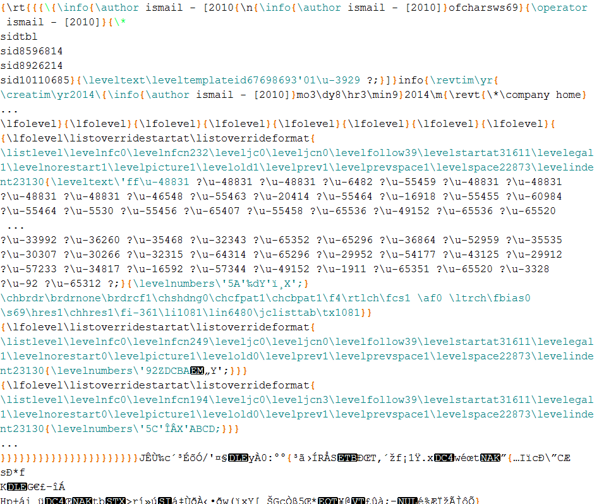
Why so easy now? – CVE-2014-1761
RTF header
Exploit trigger
Initial ROP chain
First stage ROP chain
First stage shellcode
Second stage shellcode + payload

Slide 8
Why so easy now? – CVE-2017-11882

Slide 9
The New World
3 exploit builders are responsible for 75+% of the attacks
Old builders are gone

Slide 10
Document types in attacks
77% of the attacks use RTF documents
… the rest by courtesy of EQN_Kit2

Slide 11
Why RTF?

Slide 12
Why RTF?
﻿{\rt
Hello VB18!
}

Slide 13
Let’s obfuscate! – Threadkit

Slide 14
Let’s obfuscate! – EQN_kit1

Slide 15
Let’s obfuscate! – EQN_kit3

Slide 16
Payloads delivered by Office exploits

Slide 17
Threadkit data sheet
Supported exploits
CVE-2017-8570
CVE-2017-11882
CVE-2018-0802
CVE-2018-4878
CVE-2018-8174
Multiple exploits in a single file
Used by high-end groups
Price: 800 USD (400 USD for update)

Slide 19
EQN_Kit2

Slide 20
The Old Phantom Crypter

Slide 21
Typical users

Slide 22
The Old Phantom Crypter
Supported exploits:
  CVE-2010-3333
  CVE-2012-0158
  CVE-2014-6352
  CVE-2015-2545
  CVE-2017-0199
  CVE-2017-8750
  CEV-2017-11882
  CVE-2018-0802
Supported file formats:
  RTF
  XLSX
  PDF
  DOCX

Slide 23
Flexible pricing

Slide 24
User base

Slide 25
Build RTF

Slide 26
Add a spoonful of obfuscation…

Slide 27
Finally wrap it in PDF

Slide 28
The 1337 Ancalog

Slide 29
Or maybe not…

Slide 30
Flashback Friday

Slide 31
Flashback Friday
vs.

Slide 32
Flashback Friday
﻿| [Content_Types].xml
|
+---docProps
| app.xml
| core.xml
|
+---xl
| | styles.xml
| | workbook.xml
| |
| +---drawings
| | | drawing1.xml
| | | vmlDrawing1.vml
| | |
| | \---_rels
| | drawing1.xml.rels
| |
| +---embeddings
| | oleObject1.bin
| |
| +---media
| | image1.jpeg
| |
| +---theme
| | theme1.xml
| |
| +---worksheets
| | | sheet1.xml
| | | sheet2.xml
| | | sheet3.xml
| | |
| | \---_rels
| | sheet1.xml.rels
| |
| \---_rels
| workbook.xml.rels
|
\---_rels
.rels

Slide 33
Flashback Friday

Slide 34
Delivered payload

Slide 35
Life cycle of an exploit
0-day APT
Early APT
Metasploit release
Commercial builders
Cybercrime
First sample in public domain
Patch released
1-2 months

Slide 36
Timeline of CVE-2017-0199
23/11/2016 | First known sample of the exploit
07/04/2017 | McAfee report about zero-day samples
08/04/2017 | FireEye first blog about the exploit
10/04/2017 | Massive Dridex distribution
10/04/2017 | Proofpoint report with first hashes
11/04/2017 | Microsoft releases the patch
11/04/2017 | FireEye releases full report
12/04/2107 | AV evasion experiments start
14/04/2017 | Metasploit module released
18/04/2017 | Builder 1 was released (based on Metasploit)
24/04/2017 | Builder 2 was released (based on Dridex)
08/05/2017 | MWI support released
19/06/2017 | Builder 3 first known sample (based on Builder 1)
23/11/2016 | First known sample of the exploit
07/04/2017 | McAfee report about zero-day samples
08/04/2017 | FireEye first blog about the exploit
10/04/2017 | Massive Dridex distribution
10/04/2017 | Proofpoint report with first hashes
11/04/2017 | Microsoft releases the patch
11/04/2017 | FireEye releases full report
12/04/2107 | AV evasion experiments start
14/04/2017 | Metasploit module released
18/04/2017 | Builder 1 was released (based on Metasploit)
24/04/2017 | Builder 2 was released (based on Dridex)
08/05/2017 | MWI support released
19/06/2017 | Builder 3 first known sample (based on Builder 1)
Notes:
April 7: Friday
April 10: Monday

Slide 37
Sic transit gloria mundi…

Slide 38
Overview
New vulnerabilities completely replaced the old ones
Easier exploits result in shorter life cycle
Emergence of the new generation of exploit builders
Criminal groups who previously had no interest in Office exploits, started to use them
Long time users of Office exploit switched to the new builders

Slide 39
Questions?
gabor.szappanos@sophos.com

