Slide 1
Static Analysis Methods for Detection of Microsoft Office Exploits
CHINTAN SHAH
VIRUS BULLETIN 2019 , LONDON

Slide 2
About Speaker
Chintan Shah
Over 14 Years in the Network Security Industry
Currently working as a Security Researcher with McAfee IPS team
Passionate about researching on targeted attacks. Uncovered multiple targeted and espionage attacks on Govt. organizations in the past
Focus on : Fuzzing, Vulnerability Research, Rev. Engg exploits and developing detection solutions for the products
2nd time speaker at Virus Bulletin

Slide 3
Agenda
MS Office threat landscape
Vulnerabilities exploited
Static analysis methods for generic detection
Rich Text Format
Office OpenXML
Microsoft Compound Binary File
Supervised Learning For Macro classification
Implementation of Engine
Initial Results

Slide 4
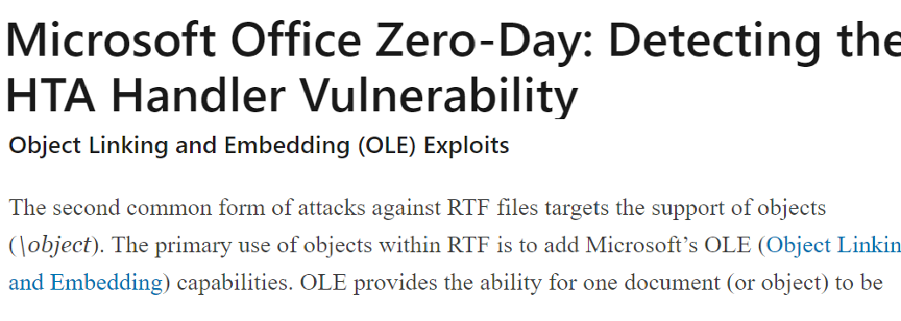

Slide 5
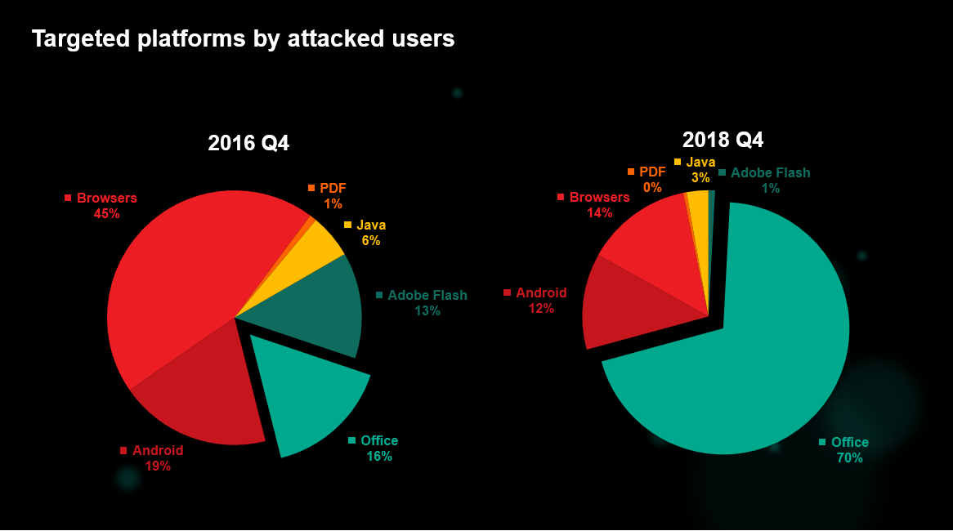
Agenda
Source: Kaspersky

Slide 6
Agenda
MS Office threat landscape
Vulnerabilities exploited
Static analysis methods for generic detection
Rich Text Format
Office OpenXML
Microsoft Compound Binary File
Supervised Learning For Macro classification
Implementation of Engine
Initial Results

Slide 7
Vulnerabilities Exploited
Parsing engine flaws ( Predominantly RTF renderers )
RTF : Complex structure with nested formatting controls
Multiple control word parsing vulnerabilities in the past
> 1800 control words – largely unexplored
Scripting engine flaws
IEs Scripting engine flaws can also be exploited via Office files
Object Linking and Embedding
Massive attack vector
Linking: Facilitates remote code download + execute
Embedding: Mem corruption exploits OR aids further exploitation

Slide 8
Static Analysis Engine for Generic Detection
Requires parsers that can extract embedded objects and streams
Handles stream and document structure obfuscations
Focus:
Detecting weaponized exploits that uses auxiliary methods without worrying about the vulnerability
Hidden code and payload inside embedded objects / streams
Containerized exploits: Extraction and re-analysis
Pointers to external code

Slide 9
Agenda
MS Office threat landscape
Vulnerabilities exploited
Static analysis methods for generic detection
Rich Text Format
Office OpenXML
Microsoft Compound Binary File
Supervised Learning For Macro classification
Implementation of Engine
Initial Results

Slide 10
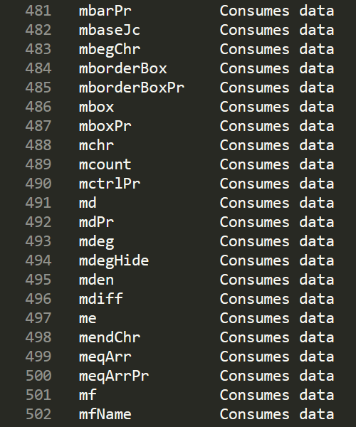
RTF – Data streams in Control words
RTF Control Words
Primarily used for document formatting
Takes parameters and data
Destination Control Words
Carries special meaning
Can consume streams of data
No restriction on the type of data it can consume
> 1000 such control words

Slide 11
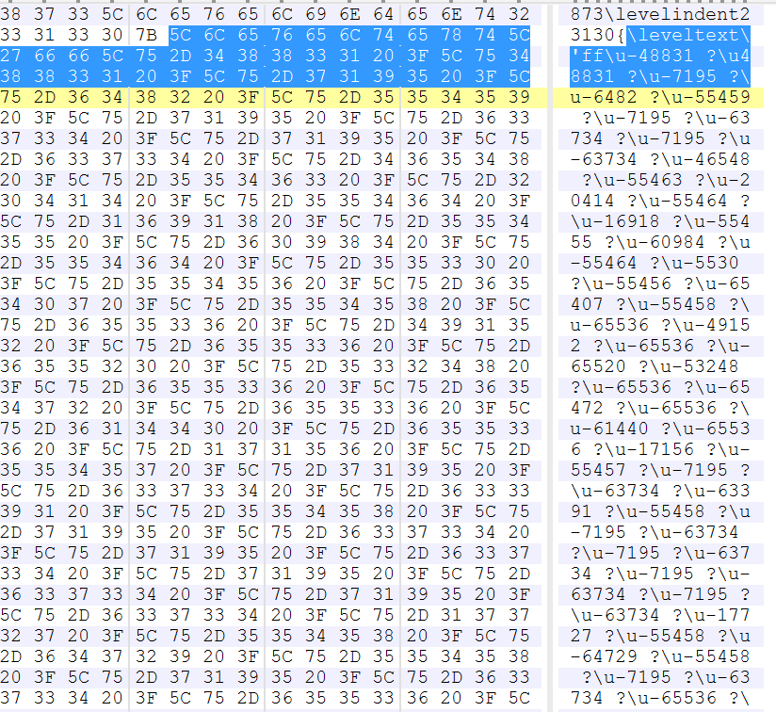
RTF – Data streams in Control words
Can be abused
Insert malicious payloads
Insert shellcodes
obfuscate stream to break immature
RTF parsers / make analysis difficult
Shellcode in “Leveltext” RTF control word
Malicious code in pFragments RTF control word

Slide 12
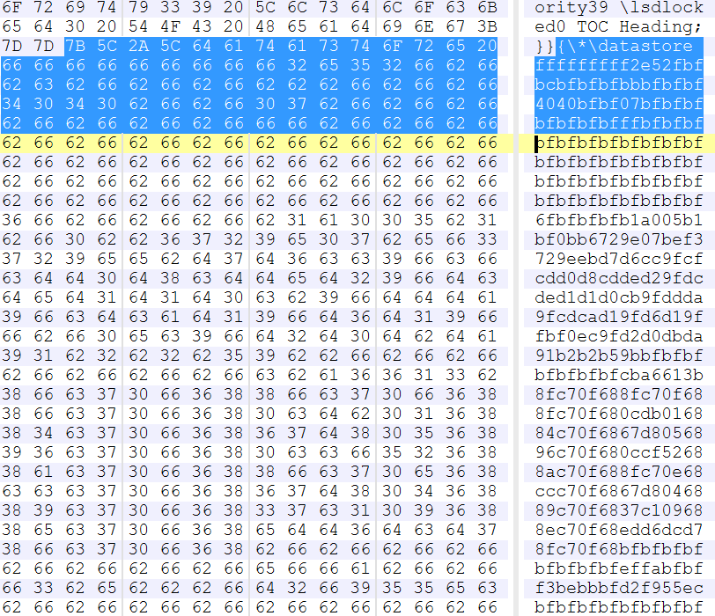
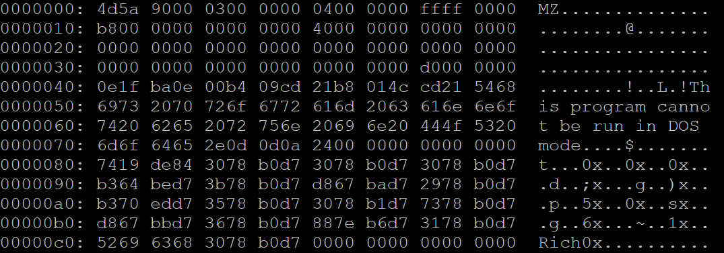
RTF – Data streams in Control words
Static Analysis
RTF readers handles obfuscation attempts
extract and scan streams to destination control words
Can detect many auxiliary strategies in the exploit
Exe file in “Datastore” control word

Slide 13
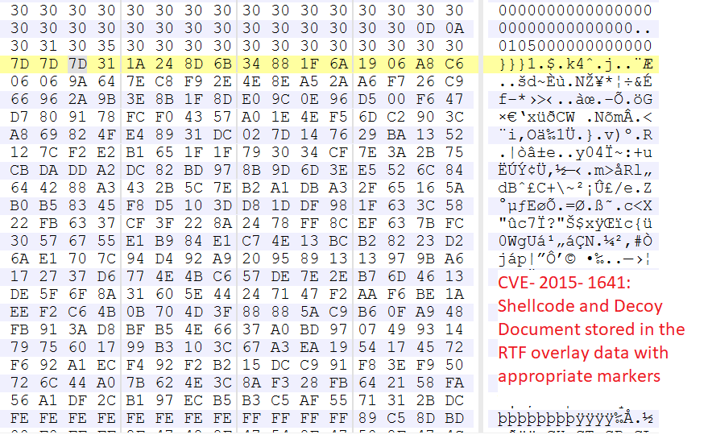
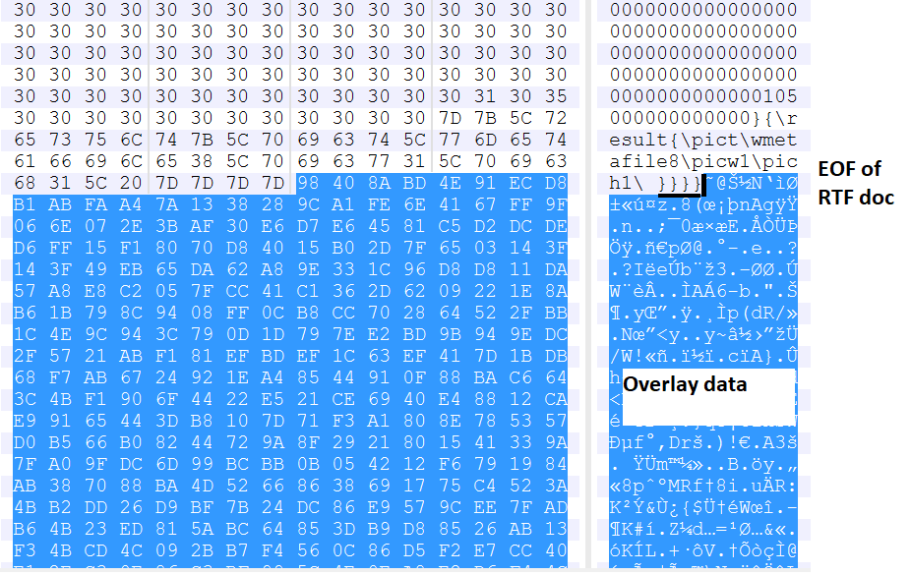
RTF – Overlay Data Streams
Overlay streams in RTF
RTF rendering engines will ignore this data while processing
Many RTF exploits appends additional streams after EOF
Another adopted auxiliary method to hide malicious resources
CVE-2015-1641 – 380 KB of overlay stream [ Stores staged shellcode and Decoy document ]
CVE-2017-11826 – 189KB of overlay stream is a red flag

Slide 14
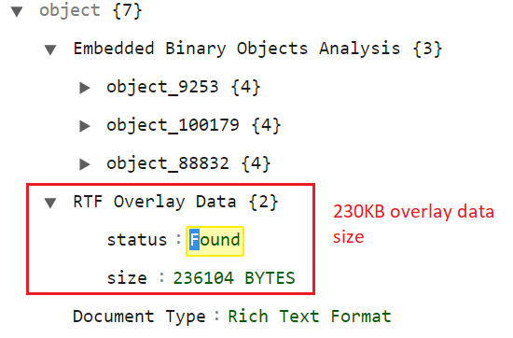
RTF – Overlay Data Streams
Static Analysis
Look for data at the end of the file
Critical to extract and analyze further for malicious indicators
Larger volumes : almost always suspicious
Size of RTF Overlay | Total RTF documents with Overlay tested: 5000
 | Total RTF documents with Overlay > 100 B: 4655
Overlay > 300 B | Total Found: 4250 | Malicious: 3973 [ 93.5%]
100 B > Overlay < = 300 B | Total Found: 405 | Malicious: 368 [ 91% ]
10 B > Overlay <= 100 B | Total Found: 345 | Malicious: 311 [ 90% ]

Slide 15
RTF – Object Linking and Embedding
OLE in RTF:
OLE objects : Stored as a data to {\object control word
OLESaveToStream : Stored in OLE1.0NativeStream format
Modifiers indicates linked or embedded object
\objemb : Embedded OLE object in RTF
\objautlink : Linked OLE object in RTF. Can be external resource
Exploitaton:
Easy: Can be quickly adapted to target victims
Recent trends : Remote code download → Invoke resp. resource handler → Code execute

Slide 16
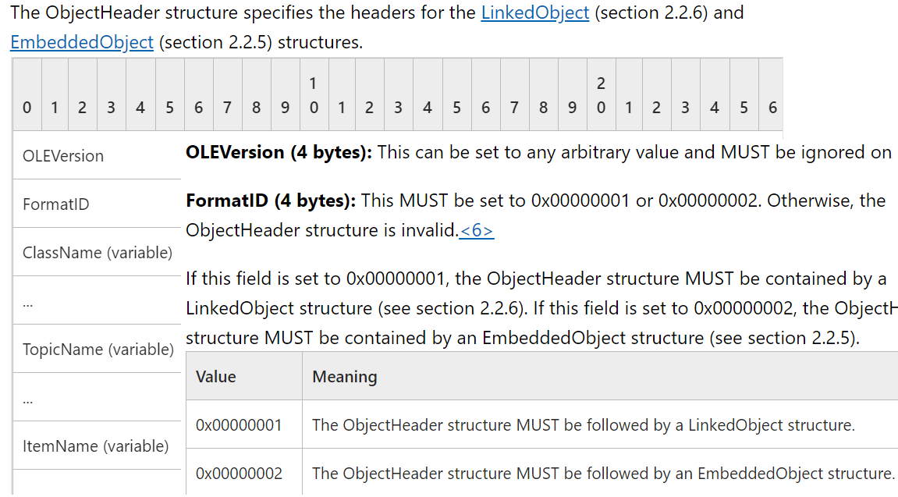
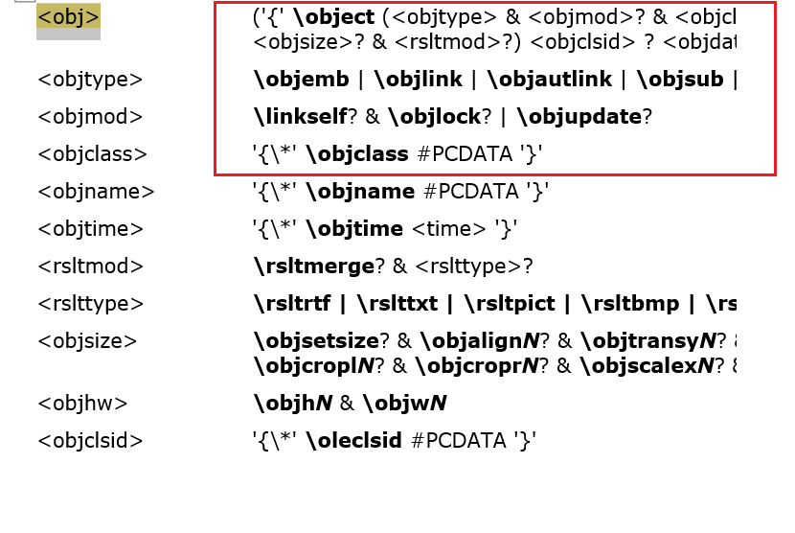
RTF – Object Linking and Embedding
OLE2 Compound Document within OLE1.0NativeStream
{\Object : Destination control word for OLE object
\objautlink : Linked object
\objclass : Class of OLE object. Word.document.8 with objautlink is linked word document to container app.
\objdata : OLE1.0NativeStream
OLE1.0NativeStream

Slide 17
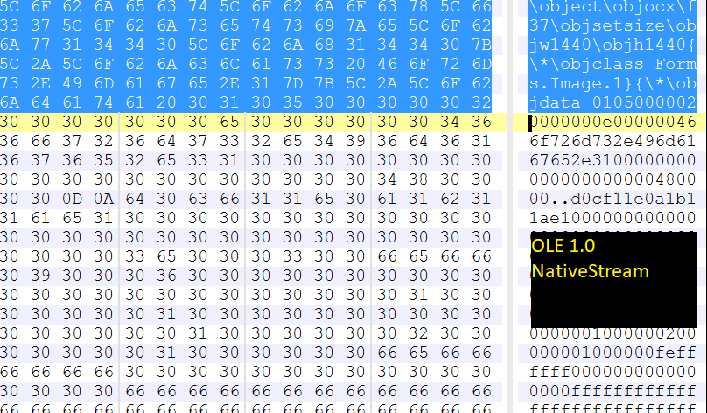
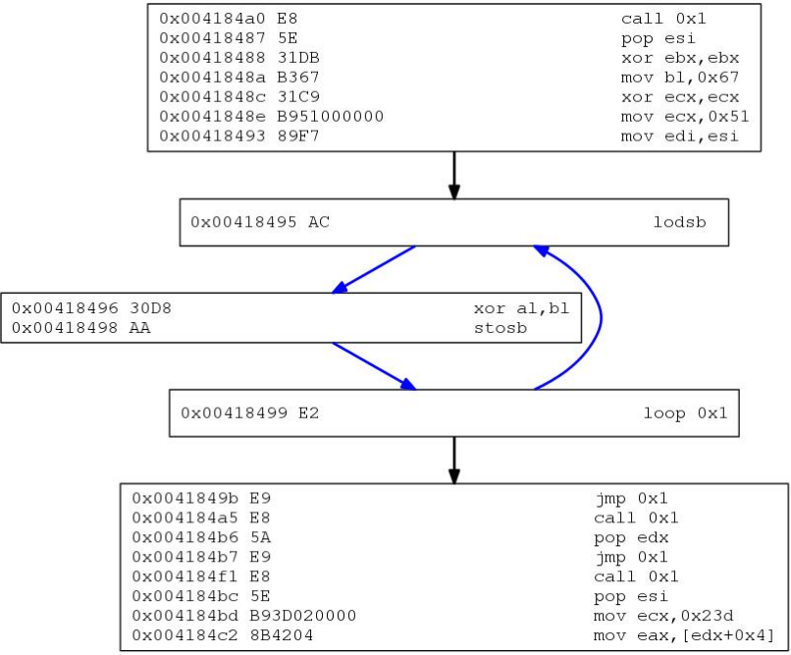
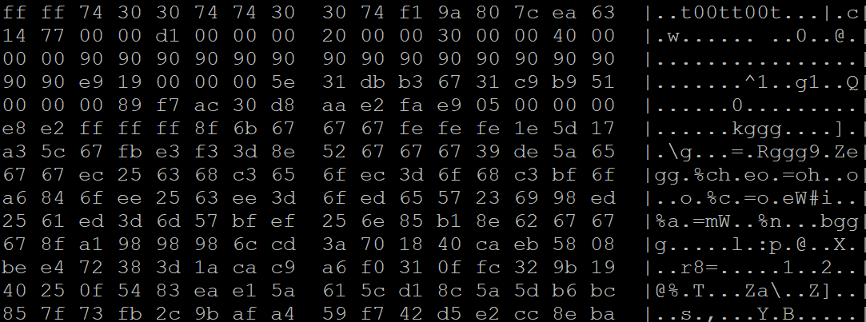
RTF – Object Linking and Embedding
CVE-2015-2424: Embedded code inside OLE object

Slide 18
RTF – File Parsing and Inspection in Static Analysis Engine
RTF FILE
Inspect file for OLE objects
\object..\objemb
\object..\objautlink
Word.document.8
Word.document.12
OLE Packages
Extract OLE1.0NativeStream Data
Extract OLE2.0 Compound Doc.
Check and Extract OOXML Documents
MS-CFB Analyzer Parse CDF extract Storage and object streams
Extract OLE packages
OOXML Analyzer Scan embedded ActiveX control for indicators
Other control words with data streams
Analyze streams for malicious indicators ( Shellcodes , extract Scripts, executables etc. - further analysis )
Extract Overlay Data

Slide 19
Agenda
MS Office threat landscape
Vulnerabilities exploited
Static analysis methods for generic detection
Rich Text Format
Office OpenXML
Microsoft Compound Binary File
Supervised Learning For Macro classification
Implementation of Engine
Initial Results

Slide 20
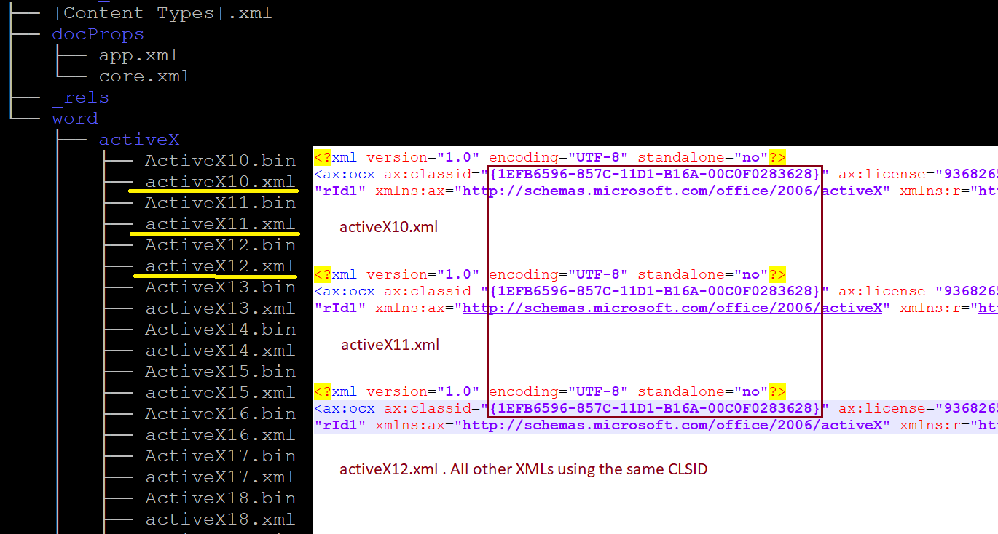
Office Open XML – COM Object Loading
Multi COM loading ( Windows mitigations bypass )
Critical to inspect ActiveX objects load mechanism on OOXML
Classic method used in many exploits for manipulating process heap

Slide 21
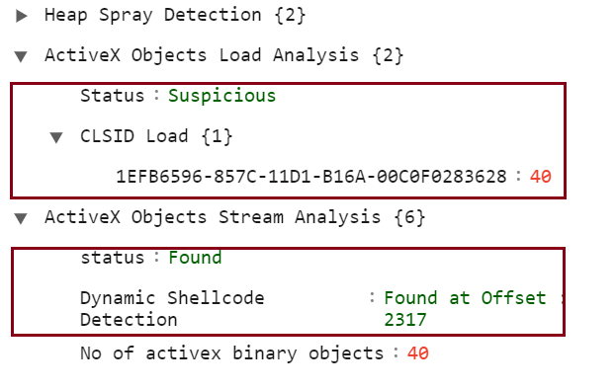
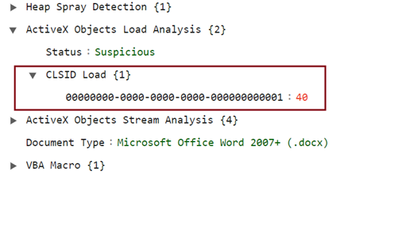
Exploitation strategies:
Load single COM object several times
Load fake objects using non existent CLSIDs
RTF as a container for OOXML exploits: Bypass Windows mitigations
CVE-2017-11826 loading non-existing CLSID

Slide 22
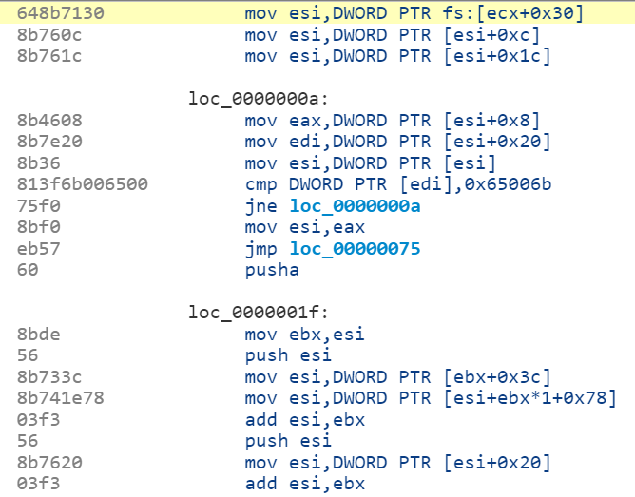
Office Open XML – Scan OLE Object streams
Static Analysis
Critical to scan object streams for possible signs of code
/activeX , /Embeddings directory should be analyzed.
OLE object : OLE2.0 format. Parse and extract storage / object streams
CVE-2017-11826 : Code embedded in OLE object stream

Slide 23
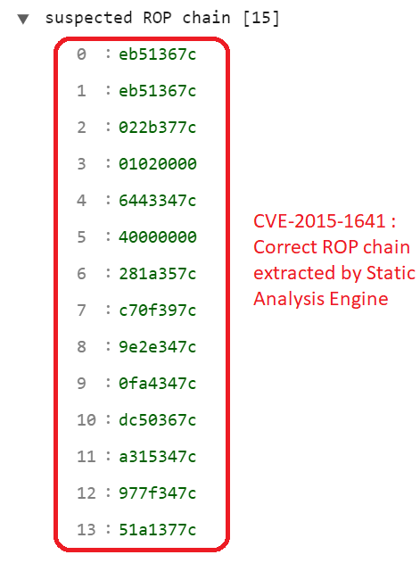
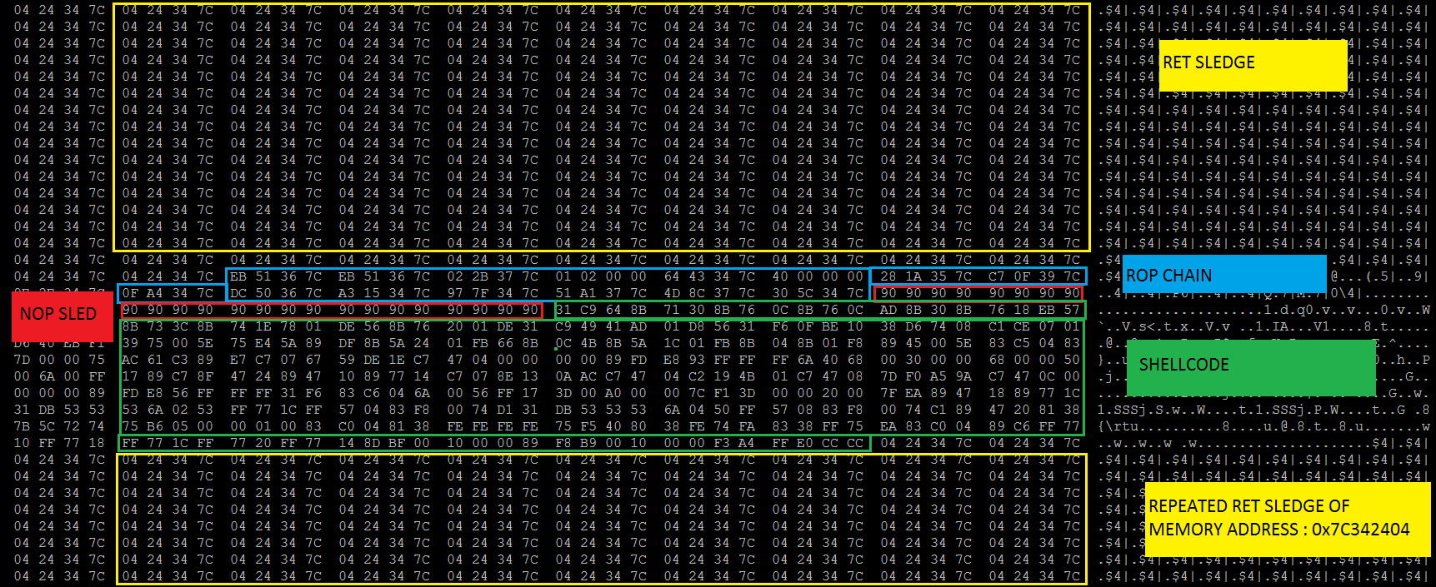
Office Open XML – Scan OLE Object streams
CVE-2015-1641 / CVE-2017-11826
Static Analysis
Critical to scan object streams for supplemental techniques as well.
Sledges , ROP chains etc.

Slide 24
Agenda
MS Office threat landscape
Vulnerabilities exploited
Static analysis methods for generic detection
Rich Text Format
Office OpenXML
Microsoft Compound Binary File
Supervised Learning For Macro classification
Implementation of Engine
Initial Results

Slide 25
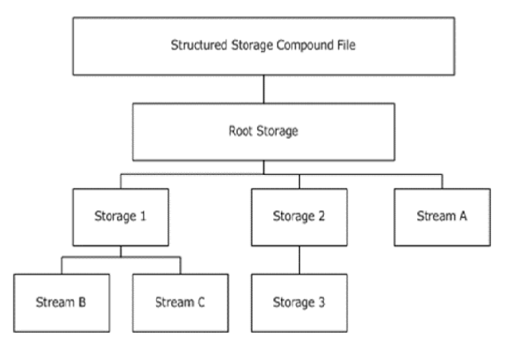
Microsoft Compound Binary File Format
Structured Storage Format
Hierarchical Data in the form of Storage and object streams
File directory sectors contains info about storage and stream objects
Specific interest :
ObjectPool storage: stores OLE object
ObjInfo + OCXDATA
Important to inspect all stream objects
_VBA Storage object : Macro code

Slide 26
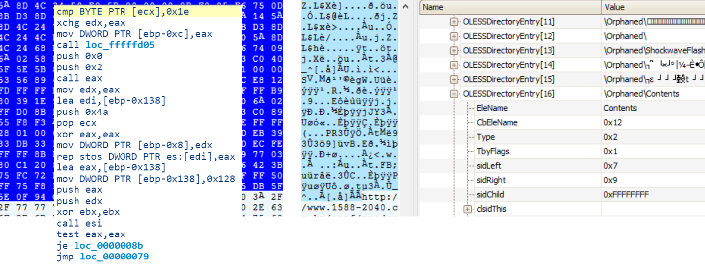
MS-CFB : Parse and extract storage streams
Static Analysis
Extract all storage and stream objects
Useful to scan all the streams ( OCXDATA in particular )
CVE-2018-4878: Malicious “Contents” object stream

Slide 27
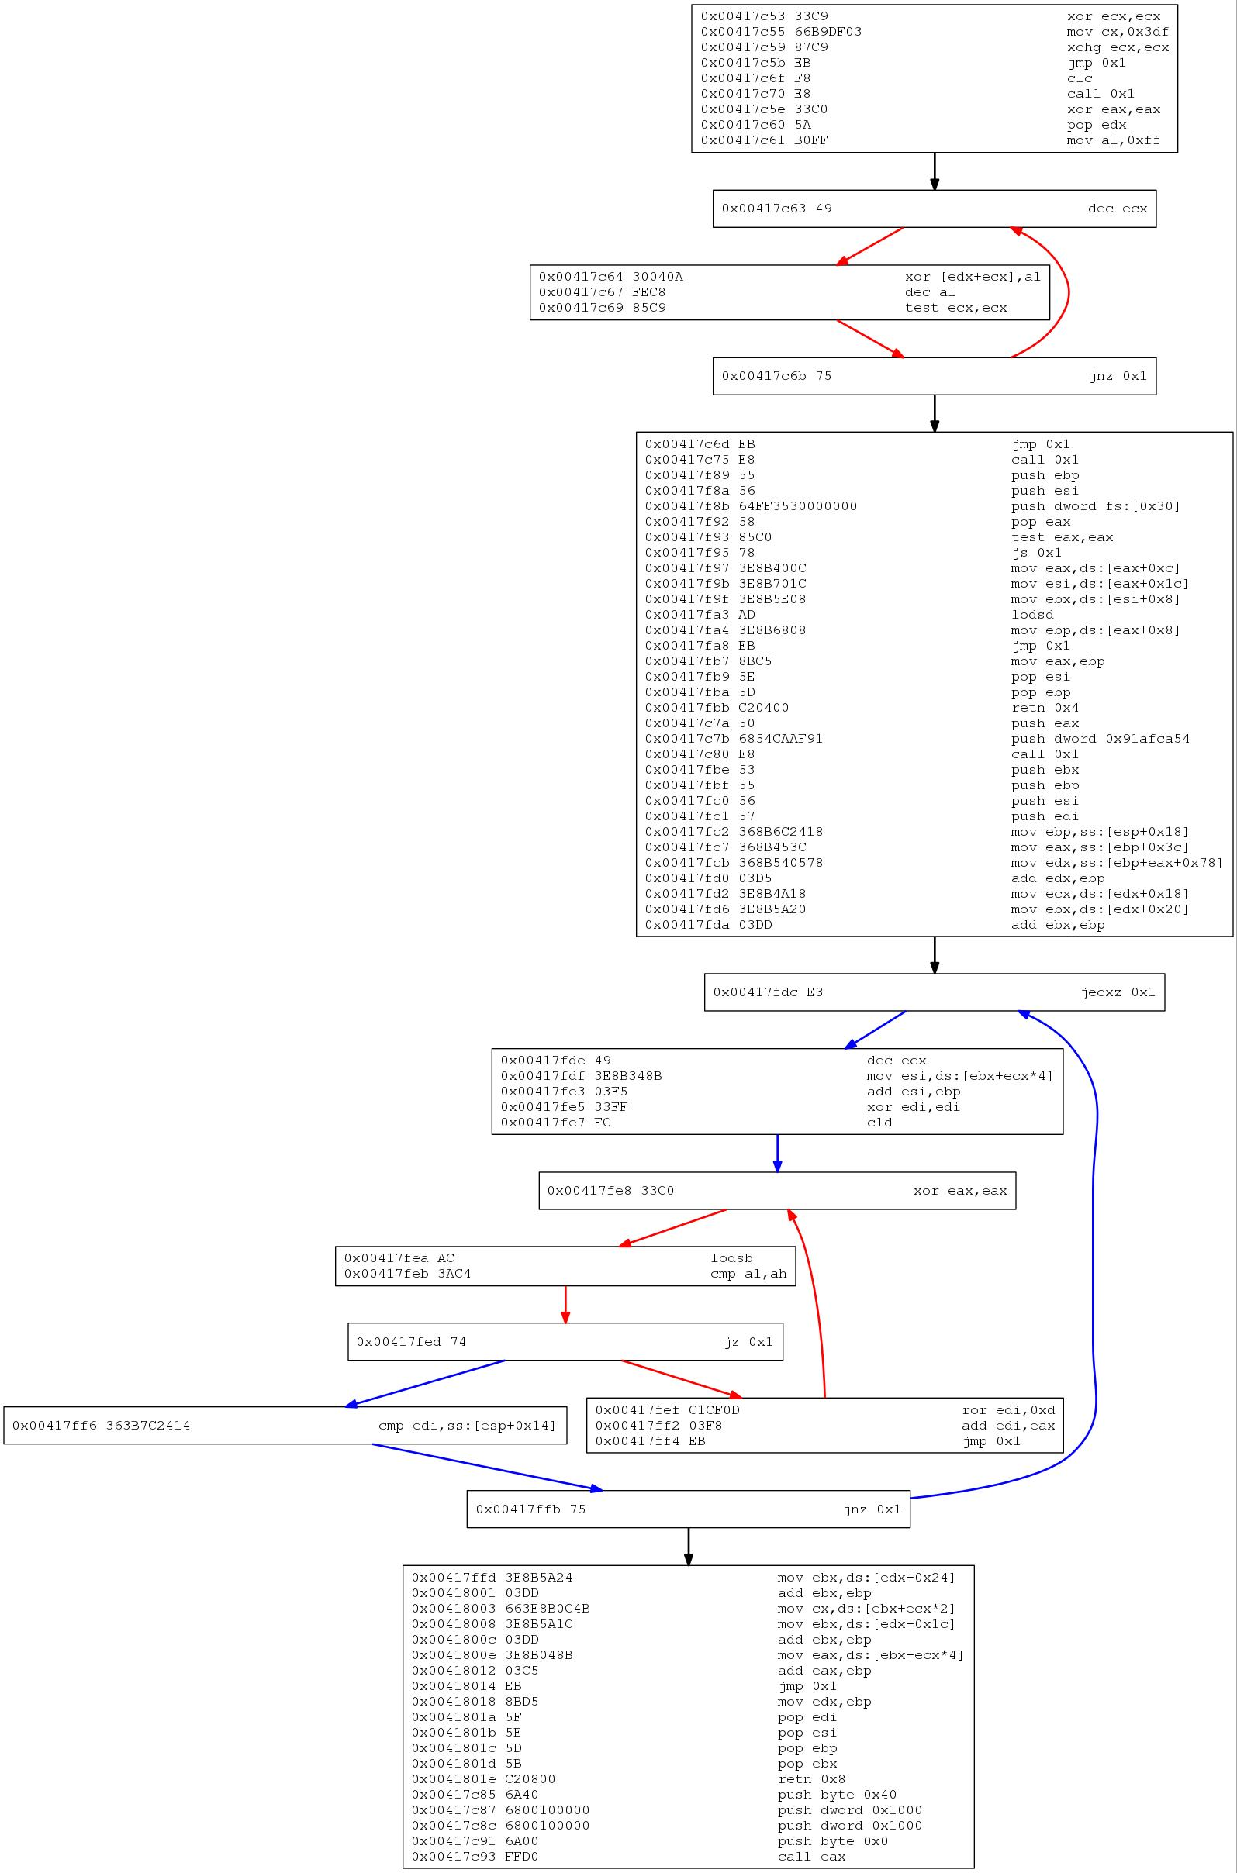
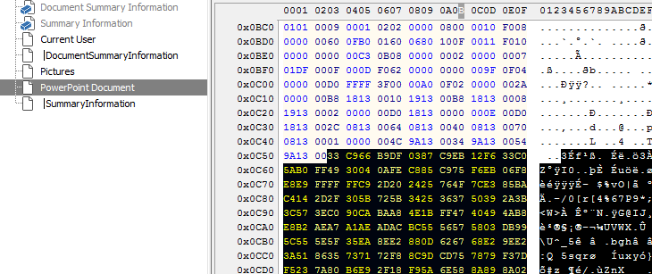
MS-CFB : Parse and extract storage streams
Code found in “Powerpoint Document” stream object

Slide 28
Agenda
MS Office threat landscape
Vulnerabilities exploited
Static analysis methods for generic detection
Rich Text Format
Office OpenXML
Microsoft Compound Binary File
Supervised Learning For Macro classification
Implementation of Engine
Initial Results

Slide 29
VB Macro Code Analysis Engine
Storage
MS-CFB : Macros ( Storage object ) → _VBA (Storage object )
/VBA/_VBA_PROJECT, /VBA/dir/ and other streams contains code
OOXML : vbaproject.bin – again OLE format as above
Analysis
Supervised learning : Multiple methods tested : Random Forest, KNN..
Decision tree found working well
 | Positive | Negative
True | 96 % | 3%
False | 0.5 % | 0.5%

Slide 30
Partial Decision Tree plot

Slide 31
Agenda
MS Office threat landscape
Vulnerabilities exploited
Static analysis methods for generic detection
Rich Text Format
Office OpenXML
Microsoft Compound Binary File
Supervised Learning For Macro classification
Implementation of Engine
Initial Results

Slide 32
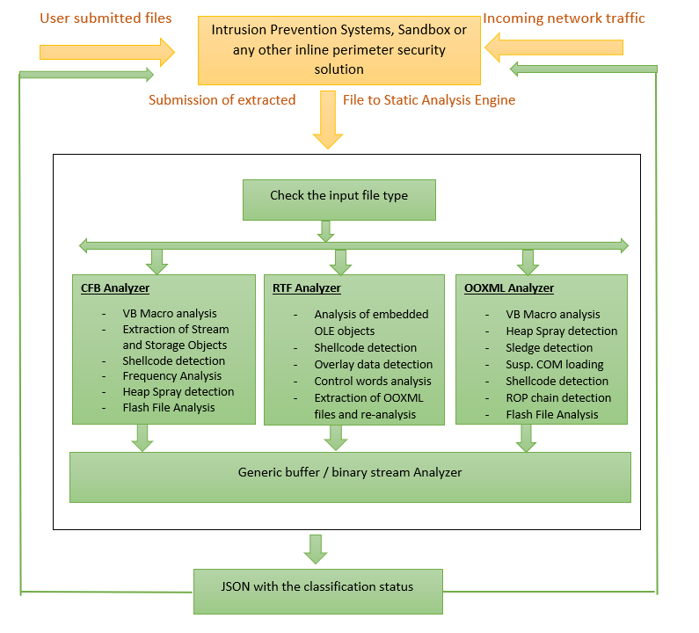
High Level View

Slide 33
Initial Results - Exploits used in Targeted Attacks
Exploit type | Type | Total Exploits | Detected | Not Detected | Detection
CVE-2012-0158 | Mixed (Targeted attacks and variants) | 2000 | 1809 | 191 | 90.4%
CVE 2013-3906 | Mixed (Targeted attacks and variants) | 150 | 150 | 0 | 100%
CVE 2014-1761 | Exploits used in targeted attacks | 35 | 29 | 6 | 83%
CVE 2015-1641 CVE-2015-2424 CVE-2015-6172 | Exploits used in targeted attacks and variants | 150 | 138 | 12 | 92%
CVE 2016-4117 | Exploits used in targeted attacks | 87 | 77 | 10 | 88.5%
CVE-2017-11882 | Exploits used in targeted attacks | 50 | 48 | 2 | 96%
CVE 2018-4878 CVE-2018-15982 | Exploits used in targeted attacks | 30 | 27 | 3 | 90%

Slide 34
Questions ???

